Slide 1



Affinity Groups
More Than Just Representation or Diversity

Slide 2
Affinity Groups - More Than Just Representation or Diversity
AbleOTUK

Slide 3
What is AbleOTUK?
An occupational therapy network/advocacy group
  Aiming to provide a voice and safe space for Occupational Therapy Practitioners, Students, Researchers, Educators, who have lived experience of disability or long term health conditions.
There has been past attempts to build this sort of network, however it never took off. Following the inspiration and motivation of other affinity groups
  AbleOTUK was born and launched July 2021.

Slide 4
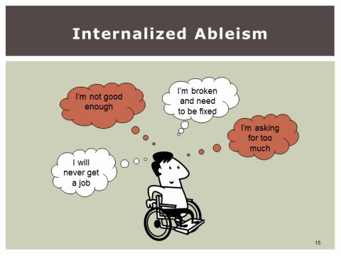
Ableism and Internal Ableism
“Ableism is discrimination in favour of non-disabled people”. (Scope n.d.)
What this means to us:
Disabling us further with attitudes, barriers and disregard.
Not recognising our strengths but focusing on what we can’t do.
Plans being made that don’t consider the impact on disabled people.
Source: (Palacios 2017)

Slide 5
The Effects of Ableism Within Occupational Therapy
Accessibility when attending training/conferences.
Lack of part time roles.
Lack of virtual and remote roles.
The fight for access to reasonable adjustments.
Reduction in leadership and research opportunities which results in lower income.
Little research on the impact of ableism in the profession.
Risk of delivering poor practice if we do not address this ableism.

Slide 6
Current Work and Future Plans
We are in regular talks with the RCOT and are in the initial stages of
  Improving support for those that identify as living with a disability and/or chronic condition.
  Setting up a steering group to advise the RCOT on accessibility and ableist concerns.
  Developing learning opportunities for members
We intend to host regular virtual learning spaces/get-togethers, whether this be independently and in collaboration with other organisations and groups.
We hosted a Discord Server for chat, for support and communication with members and allies.
We are developing a range of resources that will be available free on our website, including
  Disclosure, Reasonable Adjustments, The Equality Act, Access to Work.
We do this whilst recognising intersectionality. WE ARE STRONGER TOGETHER

Slide 7
Contact
Email: ableotuk@gmail.com
Twitter: @AbleOTUK
Instagram: @AbleOTs
Website: https://affinot.co.uk/ableotuk/
Discord: https://discord.com
YouTube: https://www.youtube.com/channel/UCFjIJNQJZBrdaUlwh2jHQnw

Slide 8
References
Palacios, M. R. (2017). Internalised Ableism. The Other Side of Ableism. [Online.] Retrieved from https://cripstory.wordpress.com/2017/07/06/the-other-side-of-ableism/
Scope. (n.d.). Disablism and ableism. [Online.] Retrieved from https://www.scope.org.uk/about-us/disablism/

Slide 9
Affinity Groups
More Than Just Representation or Diversity

Slide 10
Welcome
Twitter -@AmerieOT
@BAMEOTUK

Slide 11
What is BAME OT UK

Slide 12
What is Racism
The Oxford Dictionary defines it as, "Prejudice, discrimination, or antagonism directed against someone of a different race based on the belief that one’s own race is superior.“
However, this is a simplified explanation of a complex issue.

Slide 13
The Effects of Racism

Slide 14
So…..
What is next ?

Slide 15
How to join and contact us.
E-mail: bameotuk@gmail.com
Twitter: @BAMEOTUK
Instagram: bameotuk
Facebook: Black, Asian and Minoritised Ethnic OT UK

Slide 16
Affinity Groups
More Than Just Representation or Diversity

Slide 17

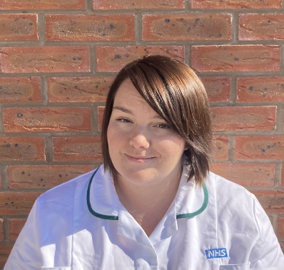



@Rachael D_OT
@LGBTQIAOTUK
LGBTQIAplusOT@gmail.com
www.affinot.co.uk/lgbtqiaotuk/

Slide 18
Who Are We?
The LGBTQIA+OTUK network was founded by a small group of occupational therapists and occupational therapy students earlier this year.
As a network, we have always been keen to connect with both individuals that identify as LGBTQIA+, as well as with our much needed allies. It has always been our aim to provide a safe space for discussion amongst peers.
The LGBTQIA+OTUK network is a space to connect, share, learn, and celebrate within the Occupational Therapy community.
@LGBTQIAOTUK
LGBTQIAplusOT@gmail.com
www.affinot.co.uk/lgbtqiaotuk/

Slide 19



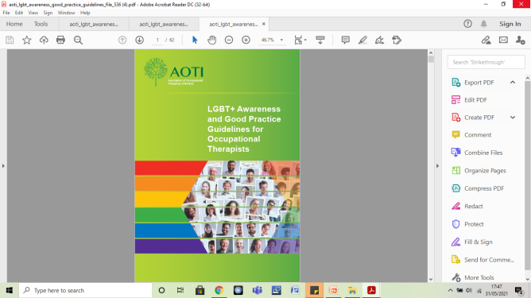
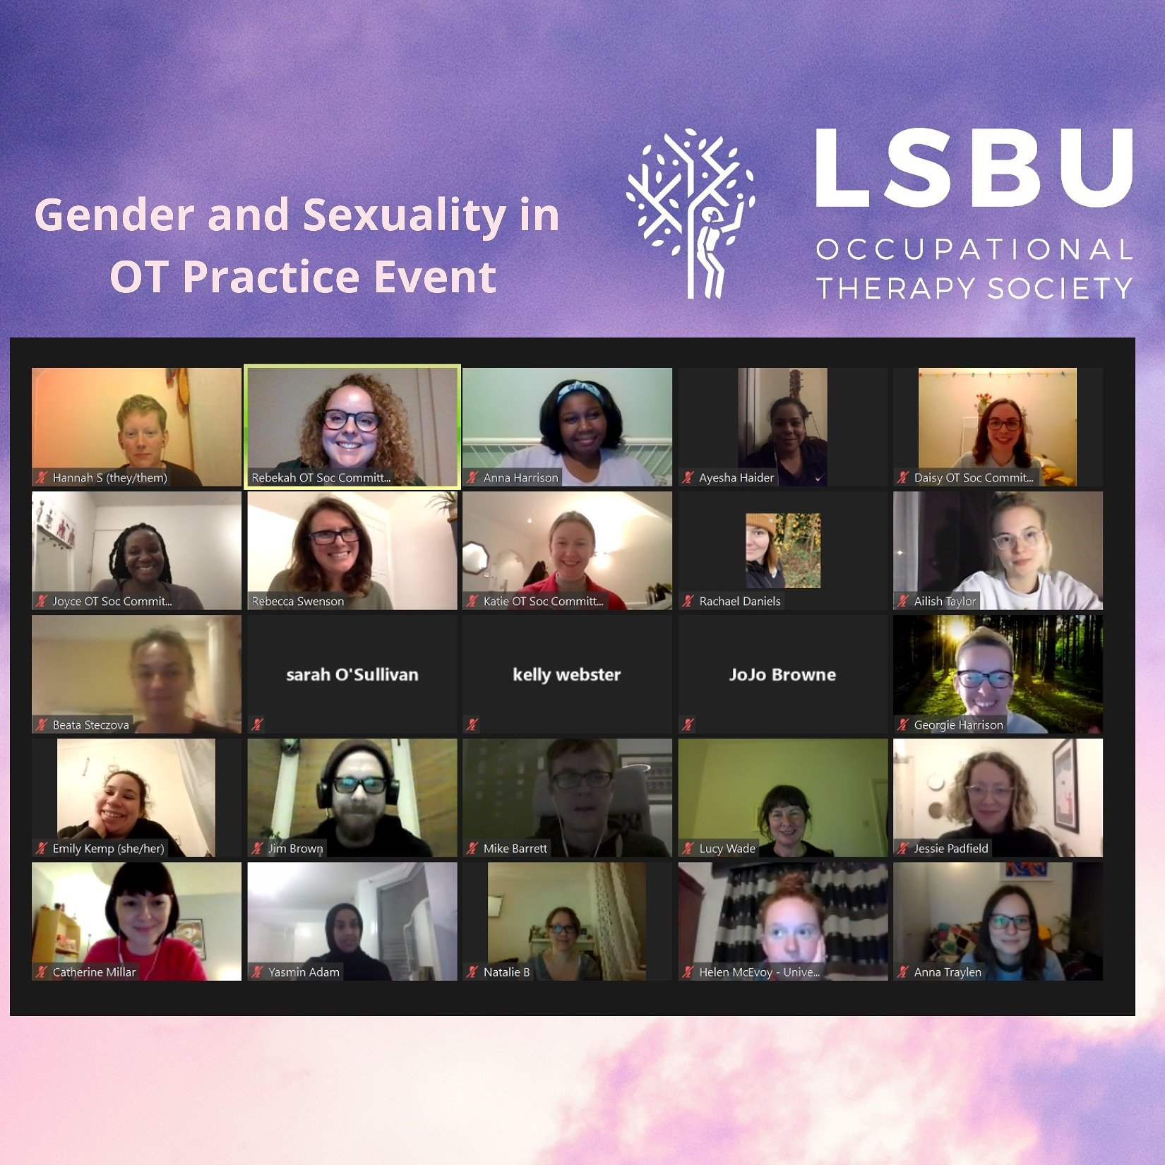
How did we get here?
26th Feb 2021
@LGBTQIAOTUK
LGBTQIAplusOT@gmail.com
www.affinot.co.uk/lgbtqiaotuk/

Slide 20



Looking to the future…
Change
Inclusion
Belonging
Visibility
@LGBTQIAOTUK
LGBTQIAplusOT@gmail.com
www.affinot.co.uk/lgbtqiaotuk/

Slide 21

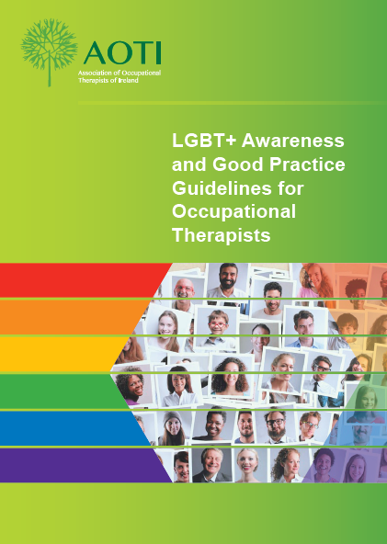



What next?
@LGBTQIAOTUK
@LGBTQIAOTUK
LGBTQIAplusOT@gmail.com
www.affinot.co.uk/lgbtqiaotuk/

