Slide 1


Enabling Success
Positive experiences of reasonable adjustments in OT Education & Practice
LIVED EXPERIENCE
AbleOTUK
ASSET & STRENGTH

Slide 2
Disclaimer
Although this presentation focuses of the positive impact of reasonable adjustments, we recognise that not everyone receives the support they need easily or consistently. Experiences can vary, and some people encounter delays or barriers.
Our aim is to acknowledge these realities while highlighting solutions and celebrating examples of good practice. All interview insights shared here are fully anonymised.
LIVED EXPERIENCE
AbleOTUK
ASSET & STRENGTH

Slide 3
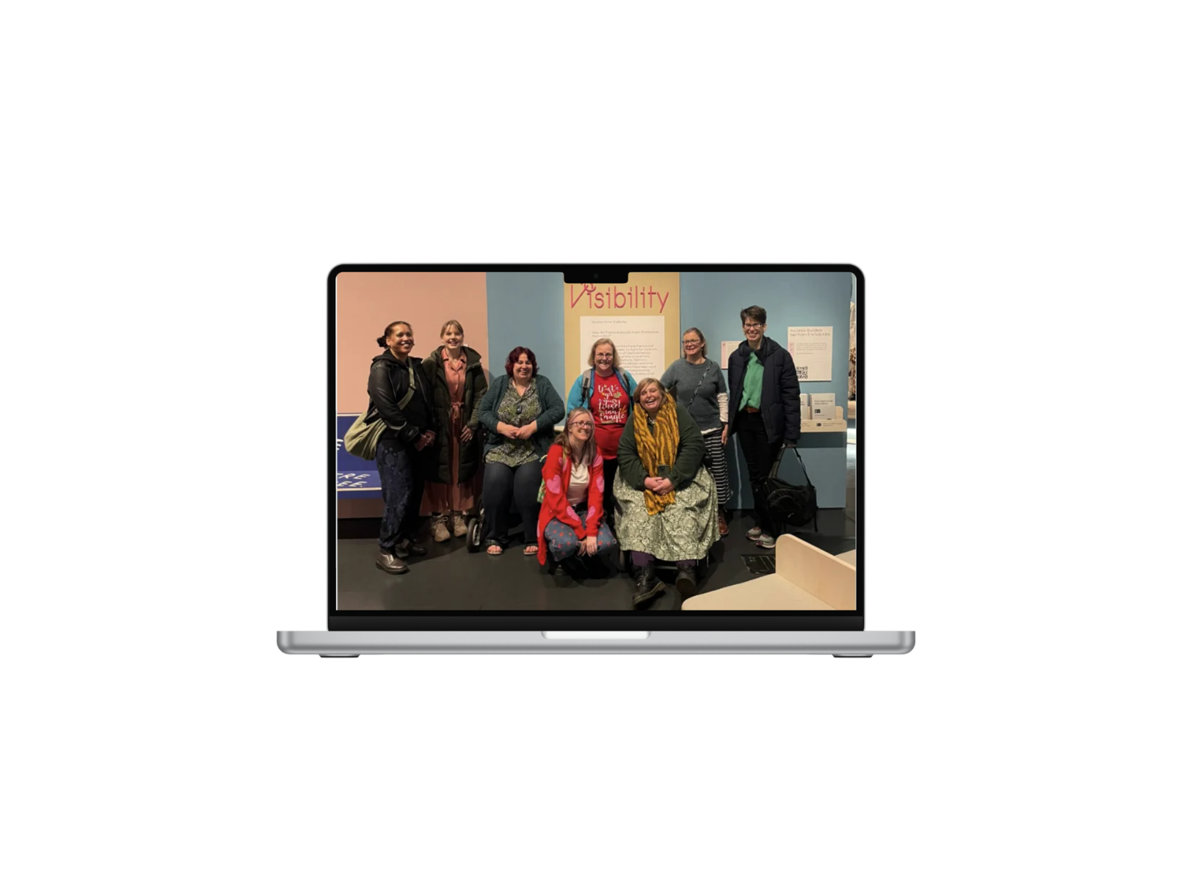




What our presentation covers
  The Equality Act, 2010
  What reasonable and unreasonable adjustments are
  Ableism in education and practice
  Our interview and feedback finding common themes
  Future resources
LIVED EXPERIENCE
AbleOTUK
ASSET & STRENGTH
Notes:
Standards development & global convening​
We connect local innovation to global standards bodies (including BSI, WHO, and ITU) and convene across sectors that rarely work together to enable adoption at scale.​
Human + AI capacity at scale​
Through CoFounder, our AI navigation layer, we extend a decade of venture and ecosystem support into continuous guidance and learning at a scale human-only models cannot reach.​
Training & capacity building​
We develop and deliver proven curricula across Africa, Asia, and the UK — building teaching infrastructure that creates trainers and long-term local capability, not dependency.

Slide 4
Defining Disability
Under the Equality Act 2010:
“A disability is a physical or mental impairment that has a substantial (more than minor or trivial) and long‑term (12 months or more) negative effect on a person’s ability to perform normal daily activities. This includes conditions that fluctuate, cause tasks to take longer, or progressively worsen over time, impacting everyday and occupational functioning.”
LIVED EXPERIENCE
AbleOTUK
ASSET & STRENGTH

Slide 5


Equality Act 2010
“The Equality Act 2010 legally protects people from discrimination in the workplace and wider society.
It replaced previous anti-discrimination laws with a single act, making the law easier to understand and strengthening protection in some situations.” (Gov.UK)
LIVED EXPERIENCE
AbleOTUK
ASSET & STRENGTH

Slide 6
Equality Act 2010
Education
  Schools cannot discriminate against disabled people and harassment, direct and indirect discrimination is not tolerated by staff or students.
  Sometimes they can be/are encouraged to treat disabled people favourably to ensure reasonable adjustments are in place to meet their individual needs/requirements. This allows students to have equal access.
  Students should benefit from reasonable adjustments and the education setting has a duty to provide these adjustments as long as they are considered reasonable.
  Cost and funding is a massive factor for accomodating these needs as some settings are unable to finacially support students to access the adjustments they require such as computers, technology or software.
LIVED EXPERIENCE
AbleOTUK
ASSET & STRENGTH
Notes:
Schools cannot discriminate against those with disabilities and harassment, direct and indirect discrimination is not tolerated by staff or students. Education environments can and is sometimes encouraged to treat those with disabilities favourably as they are ensuring reasonable adjustments are out in place to meet their individual needs and requirements. This allows disabled individuals to be on the same sort of level as students without disabilities and will enhance their education. Students should benefit from reasonable adjustments put in place and the education setting has the duty to provide these adjustments if they are considered reasonable. Cost and funding is a massive factor when it comes to reasonable adjustments as some education settings will not be in a financial situation where they can provide them (computers and technology/software for example). Schools must have accessibility plans. This can be split into 3 sections: enhancing participation, having an enabling environment, and making sure information is easily accessible and available. These have to be reviewed regularly to see if any adjustments or modifications need to be made.
(Department for Education, 2014)
Education Settings:

Slide 7
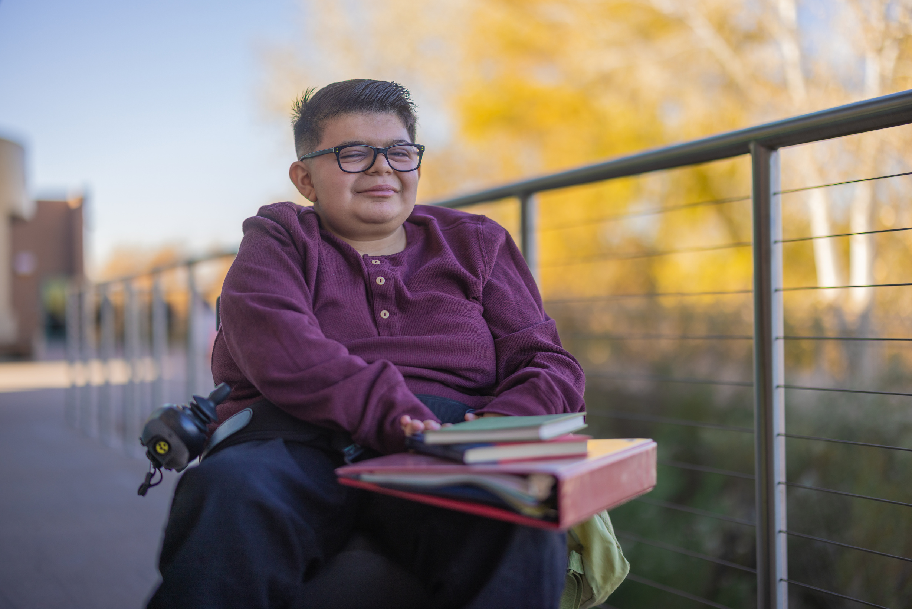
Equality Act 2010
Education
cont.
Education settings must have accessibility plans, which can be split into 3 sections:
  Enhancing participation
  Having an enabling environment
  Making sure information is easily accessible and available
These have to be reviewed regularly to see if any adjustments or modifications need to be made as well as updating for any new best practice guidelines.
LIVED EXPERIENCE
AbleOTUK
(Department for Education, 2014, Educating Settings)
ASSET & STRENGTH
Notes:
Schools must have accessibility plans. This can be split into 3 sections: enhancing participation, having an enabling environment, and making sure information is easily accessible and available. These have to be reviewed regularly to see if any adjustments or modifications need to be made.
(Department for Education, 2014)
Education Settings:

Slide 8

Equality Act 2010
Workplace Settings
Employers cannot discriminate against disabled people when it comes to:
  Application forms
  Interview arrangements
  Job offers
  Aptitude of proficency tests
  Terms of employment, including pay
  Promotion, transfer or training opportunities
  Disciplines and grievances
LIVED EXPERIENCE
AbleOTUK
ASSET & STRENGTH
Notes:
According to the UK Government (2010), employers cannot discriminate against those with disabilities when it comes to:
Application forms
Interview arrangements
Job offers
Aptitude of proficiency tests
Terms of employment, including pay
Promotion, transfer, or training opportunities
Dismissal or redundancy
Disciplines and grievances
The employer must keep the employees disability they have disclosed confidential unless the individual has stated that they are happy or okay with other people knowing about it. They must have consent and have a discussion about what can be disclosed, who it can be shared with, and whether through employer or employee shares the information. However, sometimes confidentiality isn’t always possibly (if it is a physical disability or for health and safety reasons etc)

Slide 9
An individual is not required to state their disability, but if they do, the employer is required to accommodate any reasonable adjustments.
Equality Act 2010
Disclosure
The employer must keep the employees disability confidential unless the individual has explicitly consented and had a discussion about what can be disclosed, who it can be shared with, and who will share the information.
An employer is legally allowed to ask if someone has a disability, but it is up to the individuals discretion if they wish to answer this. The employer may ask for this information to review their diversity, mitigate health and safety concerns or to ensure that there is no indirect discrimination in the hiring process.
LIVED EXPERIENCE
AbleOTUK
ASSET & STRENGTH
Notes:
According to the UK Government (2010), employers cannot discriminate against those with disabilities when it comes to:
Application forms
Interview arrangements
Job offers
Aptitude of proficiency tests
Terms of employment, including pay
Promotion, transfer, or training opportunities
Dismissal or redundancy
Disciplines and grievances
The employer must keep the employees disability they have disclosed confidential unless the individual has stated that they are happy or okay with other people knowing about it. They must have consent and have a discussion about what can be disclosed, who it can be shared with, and whether through employer or employee shares the information. However, sometimes confidentiality isn’t always possibly (if it is a physical disability or for health and safety reasons etc)

Slide 10
Equality Act 2010
Discrimination
Direct and indirect discrimination, harassment, ableism and victimisation is prohibited in the working environment. The employer has a duty to protect the disabled individual from any sort of discrimination in the work environment and they should not be treated unfairly due to disability.
Employers must make any changes and reasonable adjustments to enhance an individual with a disability performance and not to be put at a disadvantage compared to those without a disability (UK Government, 2010).
LIVED EXPERIENCE
AbleOTUK
ASSET & STRENGTH
Notes:
According to the UK Government (2010), employers cannot discriminate against those with disabilities when it comes to:
Application forms
Interview arrangements
Job offers
Aptitude of proficiency tests
Terms of employment, including pay
Promotion, transfer, or training opportunities
Dismissal or redundancy
Disciplines and grievances
The employer must keep the employees disability they have disclosed confidential unless the individual has stated that they are happy or okay with other people knowing about it. They must have consent and have a discussion about what can be disclosed, who it can be shared with, and whether through employer or employee shares the information. However, sometimes confidentiality isn’t always possibly (if it is a physical disability or for health and safety reasons etc)

Slide 11
What are
Reasonable Adjustments
  Changes an employer is legally required to make under the Equality Act 2010 to remove or reduce the disadvantages a disabled person may face at work.
  These adjustments must be tailored to the individual and may include finding alternative ways of completing tasks, altering working arrangements, modifying the workplace, or providing equipment, support, or services.
  An adjustment is considered reasonable when it effectively reduces the disadvantage, is practical to implement, is low‑cost or affordable for the organisation, and does not compromise the safety or wellbeing of others in the workplace. (ACAS, 2022).
Notes:
Subhead: Brilliant ideas, disconnected support, vulnerable people waiting longest​
Six Contexts Where Innovation Stalls:​
Assistive Technology Ventures trapped in the "TRL 5 valley of death"—prototypes validated but lacking pathways to scale. Only 11% of AT innovation is openly shared; duplication
drains scarce funding. Smart white canes reinvented dozens of times across continents while users wait for solutions that already exist elsewhere.​
Humanitarian Response, Displacement & Mental Health Crisis-driven innovation produces one-off solutions with no learning loops. Emergency interventions rarely transition to
sustainable systems. Research conducted in refugee and migrant communities generates insights that never become intervention. Mental health and psychosocial support
remains disconnected from technology innovation, even though trauma profoundly shapes how people interact with devices and systems. When the crisis moves, the knowledge
evaporates.​
Communication & Digital Inclusion Major speech and language AI datasets exclude people with impaired speech entirely. Digital literacy programs operate in silos, disconnected
from formal education systems. Local languages remain unsupported by global technology platforms, locking communities out of digital economies.​
Medical Devices & Clinical Innovation Prosthetics and orthotics designed through one-off case studies never scale beyond individual success stories. Local fabrication remains
informal, unable to access formal procurement systems. Clinical validation pathways too expensive and complex for community-led innovations.​
Community Repair & Local Production Repair knowledge exists but remains tacit, not systematized. Component supply chains don't reach last-mile contexts. Local makers lack
connection to standards bodies, preventing integration into formal systems. Devices abandoned not because they fail, but because repair infrastructure doesn't exist.​
Economic Inclusion & Innovation Pathways Disabled people, refugees, and marginalized communities face compounding barriers to economic participation. Excluded from
digital skills programs. Training delivered without employment pathways. No routes into innovation, research, or technology careers despite lived expertise. Programs addressing
their needs proceed without their leadership. This isn't just about current exclusion—it's about perpetuating it. The people who understand barriers best have no pathway to
become the technologists, researchers, and entrepreneurs who solve them.​
Closing line: "These ecosystems share a pattern: brilliant innovation, fragmented support, vulnerable people left behind."

Slide 12




Reasonable adjustments
in college, university, and the workplace
You do not need a diagnosis
Types of reasonable adjustments
Collaborative working
Asking for reasonable adjustments
You can request adjustments without having a diagnosis or disability (ACAS, 2022).
E.g., someone who suffers from backpain might request a chair that is meant to reduce aches and has a set back to it. The adjustments are meant to enhance an individuals ability to perform their role/job and it is down to the organisation to try and meet these needs if they can.
It is important that you collaborate and work together with your employer or tutor/disability advisor/ whoever can provide support when it comes to getting adjustments in your environment.
This ensures good communication on both sides, so you can work together to come up with a plan to help implement these adjustments and come up with ideas together to face any challenges.
This makes the process client centred and personal to them.
Collaboration also ensures that there is a review process so that you can amend anything to meet your needs.
College/University:
Speak to the educations disabilities advisor or personal tutor to see if they can put anything in place
Workplace:
Typically you would contact your manager/employer for any reasonable adjustments to be considered and you could do this via email or a meeting
(ACAS, 2022)
If it is a meeting you are legally allowed to have someone else in the room with you to act as an advocate.
(Scope, 2026)
Some common reasonable adjustments:
  having a reader or interpreter
  flexible hours (earlier or later starting and finishing times)
  one on one support (meetings)
  having larger font size on paper and having coloured paper to make information easier to read
  regular breaks throughout the day
  additional time with certain tasks
  having a notetaking software
This applies to all workers, students, including trainees, apprentices, contract workers and business partners
Notes:
Innovation stalls between prototype and adoption​
Promising solutions lack clear, sequenced pathways through evidence, regulation, procurement, and financing, causing repeated drop-off after validation.​
​
Support is fragmented and poorly sequenced​
Research, humanitarian pilots, accelerators, and skills programmes operate in silos, forcing teams to rebuild the same infrastructure over and over again.​
​
Evidence is generated but does not travel​
High-quality learning remains trapped in reports, institutions, or projects, instead of shaping standards, policy, and future innovation elsewhere.​
​
Local capability is engaged but not embedded​
Communities contribute insight and delivery, but lack ownership, standards pathways, and long-term decision-making power, leaving systems fragile.​
​
Knowledge silos waste scarce resources​
Only a small fraction of innovation operates as open, reusable knowledge, driving duplication and slowing progress for those waiting longest.

Slide 13
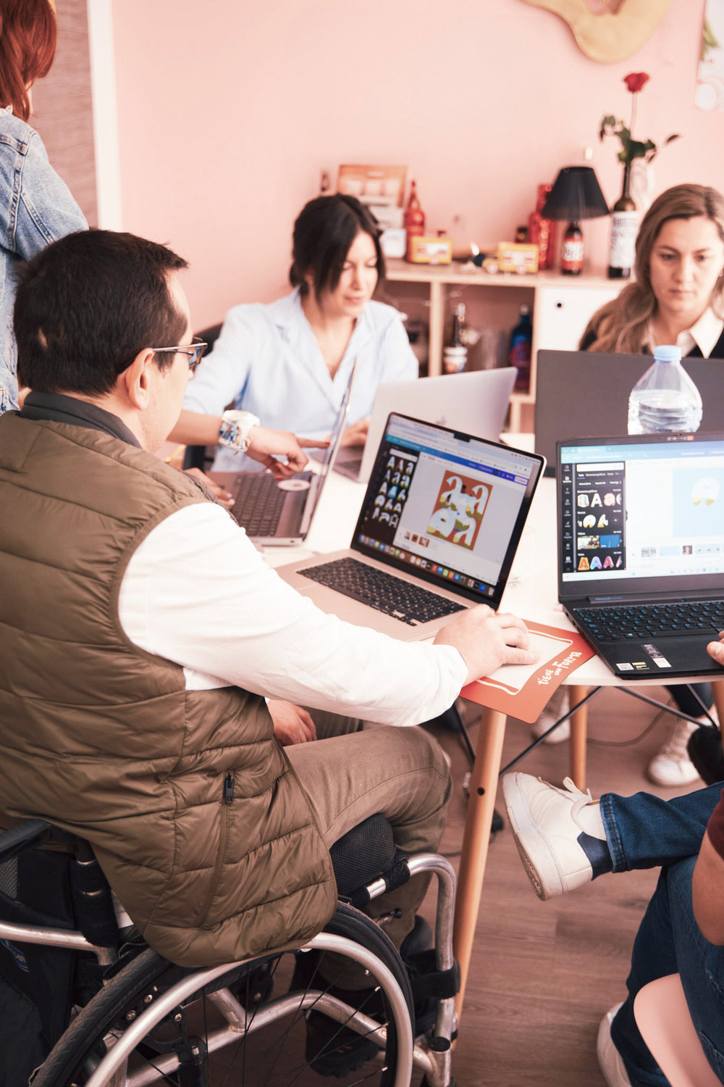
Unreasonable Adjustments
Feasibility:
Some adjustments may be considered unreasonable if they are not realistically achievable for the organisation, such as requiring major structural changes or resources they cannot provide. Even when one option isn’t feasible, alternative adjustments can usually still be explored to reduce barriers.
(ACAS, 2022)
1
2
Fundamentally change the role:
An adjustment becomes unreasonable if it removes essential duties that define the core purpose of the role. While core responsibilities must remain intact, tasks can often be adapted, graded, or supported in different ways to maintain participation.
(UK Government, 2010)
3
Significant safety risk:
Adjustments may be unreasonable if they create a substantial health or safety risk for the individual, collegues, or service users. In these situations, safer alternative adjustments can usually be idenitified to support inclusion without compromising safety.
(ACAS, 2022)
Notes:
Subhead: Brilliant ideas, disconnected support, vulnerable people waiting longest​
Six Contexts Where Innovation Stalls:​
Assistive Technology Ventures trapped in the "TRL 5 valley of death"—prototypes validated but lacking pathways to scale. Only 11% of AT innovation is openly shared; duplication
drains scarce funding. Smart white canes reinvented dozens of times across continents while users wait for solutions that already exist elsewhere.​
Humanitarian Response, Displacement & Mental Health Crisis-driven innovation produces one-off solutions with no learning loops. Emergency interventions rarely transition to
sustainable systems. Research conducted in refugee and migrant communities generates insights that never become intervention. Mental health and psychosocial support
remains disconnected from technology innovation, even though trauma profoundly shapes how people interact with devices and systems. When the crisis moves, the knowledge
evaporates.​
Communication & Digital Inclusion Major speech and language AI datasets exclude people with impaired speech entirely. Digital literacy programs operate in silos, disconnected
from formal education systems. Local languages remain unsupported by global technology platforms, locking communities out of digital economies.​
Medical Devices & Clinical Innovation Prosthetics and orthotics designed through one-off case studies never scale beyond individual success stories. Local fabrication remains
informal, unable to access formal procurement systems. Clinical validation pathways too expensive and complex for community-led innovations.​
Community Repair & Local Production Repair knowledge exists but remains tacit, not systematized. Component supply chains don't reach last-mile contexts. Local makers lack
connection to standards bodies, preventing integration into formal systems. Devices abandoned not because they fail, but because repair infrastructure doesn't exist.​
Economic Inclusion & Innovation Pathways Disabled people, refugees, and marginalized communities face compounding barriers to economic participation. Excluded from
digital skills programs. Training delivered without employment pathways. No routes into innovation, research, or technology careers despite lived expertise. Programs addressing
their needs proceed without their leadership. This isn't just about current exclusion—it's about perpetuating it. The people who understand barriers best have no pathway to
become the technologists, researchers, and entrepreneurs who solve them.​
Closing line: "These ecosystems share a pattern: brilliant innovation, fragmented support, vulnerable people left behind."

Slide 14
Ableism in Education & Practice
at a system level
Assumptions about capability:
People may assume disabled student or service users are less capable, which can limit opportunities and undermine autonomy. These assumptions conflict with person-centred, non-discriminatory OT practice.
“Just because you may not have encountered something before… don’t write something or someone off”
Lack of understanding
Limited awareness of disability, especially invisible or fluctuating conditions, leads to unfair expectations, judgement, and inaccessible learning or practice environments. This reduces participation and inclusion.
“Don’t be dismissive of the person based on disability”
Inconsistent support:
Adjustments and accommodations are often applied unevenly, depending on staff attitudes rather than clear systems. This inconsistency creates barriers, reduces trust, and impacts occupational engagements.
Microaggressions:
Microaggressions are subtle types of indirect discrimination towards individuals with a disability. This can be verbally or through actions. These types of comments and behaviours can impact an individual’s mental health and well being, confidence, occupational participation, sense of belonging/community, as well as engagement in education or work. There are 3 types of microaggressions: microassults, microinvalidation, and microinsults (disAbility Law Center of Virginia, 2023).
Systemic barriers:
Policies, environments, and structures often prioritise non‑disabled norms. Inflexible assessments, inaccessible buildings, and restrictive service criteria limit equitable.
“See people’s strengths before seeing the disabilities”
Notes:
Subhead: Brilliant ideas, disconnected support, vulnerable people waiting longest​
Six Contexts Where Innovation Stalls:​
Assistive Technology Ventures trapped in the "TRL 5 valley of death"—prototypes validated but lacking pathways to scale. Only 11% of AT innovation is openly shared; duplication
drains scarce funding. Smart white canes reinvented dozens of times across continents while users wait for solutions that already exist elsewhere.​
Humanitarian Response, Displacement & Mental Health Crisis-driven innovation produces one-off solutions with no learning loops. Emergency interventions rarely transition to
sustainable systems. Research conducted in refugee and migrant communities generates insights that never become intervention. Mental health and psychosocial support
remains disconnected from technology innovation, even though trauma profoundly shapes how people interact with devices and systems. When the crisis moves, the knowledge
evaporates.​
Communication & Digital Inclusion Major speech and language AI datasets exclude people with impaired speech entirely. Digital literacy programs operate in silos, disconnected
from formal education systems. Local languages remain unsupported by global technology platforms, locking communities out of digital economies.​
Medical Devices & Clinical Innovation Prosthetics and orthotics designed through one-off case studies never scale beyond individual success stories. Local fabrication remains
informal, unable to access formal procurement systems. Clinical validation pathways too expensive and complex for community-led innovations.​
Community Repair & Local Production Repair knowledge exists but remains tacit, not systematized. Component supply chains don't reach last-mile contexts. Local makers lack
connection to standards bodies, preventing integration into formal systems. Devices abandoned not because they fail, but because repair infrastructure doesn't exist.​
Economic Inclusion & Innovation Pathways Disabled people, refugees, and marginalized communities face compounding barriers to economic participation. Excluded from
digital skills programs. Training delivered without employment pathways. No routes into innovation, research, or technology careers despite lived expertise. Programs addressing
their needs proceed without their leadership. This isn't just about current exclusion—it's about perpetuating it. The people who understand barriers best have no pathway to
become the technologists, researchers, and entrepreneurs who solve them.​
Closing line: "These ecosystems share a pattern: brilliant innovation, fragmented support, vulnerable people left behind."

Slide 15

Interviewees
Deep Dive

Slide 16

Interviewees
All information provided to us was completely anonymised and kept confidential.
In total, we had 6 participants, we reviewed the data and compiled key themes that appeared throughout all 6 interviews.
Notes:
Subhead: Brilliant ideas, disconnected support, vulnerable people waiting longest​
Six Contexts Where Innovation Stalls:​
Assistive Technology Ventures trapped in the "TRL 5 valley of death"—prototypes validated but lacking pathways to scale. Only 11% of AT innovation is openly shared; duplication
drains scarce funding. Smart white canes reinvented dozens of times across continents while users wait for solutions that already exist elsewhere.​
Humanitarian Response, Displacement & Mental Health Crisis-driven innovation produces one-off solutions with no learning loops. Emergency interventions rarely transition to
sustainable systems. Research conducted in refugee and migrant communities generates insights that never become intervention. Mental health and psychosocial support
remains disconnected from technology innovation, even though trauma profoundly shapes how people interact with devices and systems. When the crisis moves, the knowledge
evaporates.​
Communication & Digital Inclusion Major speech and language AI datasets exclude people with impaired speech entirely. Digital literacy programs operate in silos, disconnected
from formal education systems. Local languages remain unsupported by global technology platforms, locking communities out of digital economies.​
Medical Devices & Clinical Innovation Prosthetics and orthotics designed through one-off case studies never scale beyond individual success stories. Local fabrication remains
informal, unable to access formal procurement systems. Clinical validation pathways too expensive and complex for community-led innovations.​
Community Repair & Local Production Repair knowledge exists but remains tacit, not systematized. Component supply chains don't reach last-mile contexts. Local makers lack
connection to standards bodies, preventing integration into formal systems. Devices abandoned not because they fail, but because repair infrastructure doesn't exist.​
Economic Inclusion & Innovation Pathways Disabled people, refugees, and marginalized communities face compounding barriers to economic participation. Excluded from
digital skills programs. Training delivered without employment pathways. No routes into innovation, research, or technology careers despite lived expertise. Programs addressing
their needs proceed without their leadership. This isn't just about current exclusion—it's about perpetuating it. The people who understand barriers best have no pathway to
become the technologists, researchers, and entrepreneurs who solve them.​
Closing line: "These ecosystems share a pattern: brilliant innovation, fragmented support, vulnerable people left behind."

Slide 17
  Lived experience strengthened empathy, creativity, and clinical reasoning.
  Adjustments enabled sustainable participation and improved quality of work.
  Participants felt more confident, capable, and aligned with OT values.
“Being believed helped me perform at my best.”
“Lived experience made me a better OT.”
Key Theme:
Enhanced Professional Practice
LIVED EXPERIENCE
AbleOTUK
ASSET & STRENGTH
Notes:
According to the UK Government (2010), employers cannot discriminate against those with disabilities when it comes to:
Application forms
Interview arrangements
Job offers
Aptitude of proficiency tests
Terms of employment, including pay
Promotion, transfer, or training opportunities
Dismissal or redundancy
Disciplines and grievances
The employer must keep the employees disability they have disclosed confidential unless the individual has stated that they are happy or okay with other people knowing about it. They must have consent and have a discussion about what can be disclosed, who it can be shared with, and whether through employer or employee shares the information. However, sometimes confidentiality isn’t always possibly (if it is a physical disability or for health and safety reasons etc)

Slide 18
  Participants became more skilled at articulating needs and navigating systems
  Supportive environments helped reduce fear around disclosure
  Positive experiences reinforced their sense of belonging in the profession
“Acceptance of others is huge”
“Being listened to, made me feel included and valued”
Key Theme:
Growth in Self-Advocacy & Confidence
LIVED EXPERIENCE
AbleOTUK
ASSET & STRENGTH
Notes:
Participants became more skilled at articulating needs and navigating systems.
Supportive environments helped reduce fear around disclosure.
Positive experiences reinforced their sense of belonging in the profession.
“Acceptance of others is huge”
“Being listened to made me feel included and valued”

Slide 19
  Supportive managers, educators and collegues who listened and adapted.
  Occupational Health teams who validated needs and advocated on participants’ behalf
  Peer support from disabled OT networks help refine adjustment requests
“The most supported I’ve felt is when my managers asked how they could help”
“The assessor was amazing and respected my expertise in my own condition”
Key Theme:
Supportive People & Relationships
LIVED EXPERIENCE
AbleOTUK
ASSET & STRENGTH
Notes:
Supportive People & Relationships:
Supportive managers, educators, and collegues who listened and adapted.
Occupational Health teams who validated needs and advocated on participants’ behalf
Peer support from disabled OT networks help refine adjustment requests.
“The most supported I’ve felt is when managers asked how they could help.”
“The assessor was amazing and respected my expertise in my own condition.”

Slide 20
  Part-time hours, flexible start/finish times and remote working
  Quiet rooms, reduced caseloads and pacing strategies improving sustainability
  Assistive tools: ergonomic seating, dictaphones, voice-to-text, footrests, sit-stand desks
“Flexible working has been the most valuable adjustment”
Key Theme:
Effective Adjustments Make a Real Difference
LIVED EXPERIENCE
AbleOTUK
ASSET & STRENGTH
Notes:
Effective Adjustments That Made a Real Difference:
Part-time hours, flexible start/finish times, and remote working
Quiet rooms, reduced caseloads, and pacing strategies improving sustainability
Assistive tools: ergonomic seating, dictaphones, voice-to-text, footrests, sit-stand desks.
“Flexible working has been the most valuable adjustment.”

Slide 21
A theme we saw come up a lot was the importance of low cost adjustments and how much of a positive impact they make.
These adjustments have enabled those with disabilities to engage, participate, and enhance successfully in their environment.
Key Theme:
Low-cost Reasonable Adjustments:
LIVED EXPERIENCE
AbleOTUK
ASSET & STRENGTH
Notes:
Effective Adjustments That Made a Real Difference:
Part-time hours, flexible start/finish times, and remote working
Quiet rooms, reduced caseloads, and pacing strategies improving sustainability
Assistive tools: ergonomic seating, dictaphones, voice-to-text, footrests, sit-stand desks.
“Flexible working has been the most valuable adjustment.”

Slide 22
  Rest breaks in exams and on placement
  Extra time for assessments and exams
  Ergonomic equipment
  Part-time hours on placement
  Having quiet spaces and rooms
  Noise-cancelling headphones
  Advance access to lecture slides
  Placement close to home
  Allowing notes in presentations
  Small exam rooms
Low-cost Reasonable Adjustments:
Education Settings
LIVED EXPERIENCE
AbleOTUK
ASSET & STRENGTH
Notes:
Effective Adjustments That Made a Real Difference:
Part-time hours, flexible start/finish times, and remote working
Quiet rooms, reduced caseloads, and pacing strategies improving sustainability
Assistive tools: ergonomic seating, dictaphones, voice-to-text, footrests, sit-stand desks.
“Flexible working has been the most valuable adjustment.”

Slide 23
  Footrests
  Gel wrist and keyboard supports
  Flexible travel times
  Working from home/flexible working
  Having quiet rooms available
  Dictaphones
  Driving own car to appointments
  Voice to text software
  Task management techniques
  Ergonomic equipment
Low-cost Reasonable Adjustments:
Workplace Settings
LIVED EXPERIENCE
AbleOTUK
ASSET & STRENGTH
Notes:
Effective Adjustments That Made a Real Difference:
Part-time hours, flexible start/finish times, and remote working
Quiet rooms, reduced caseloads, and pacing strategies improving sustainability
Assistive tools: ergonomic seating, dictaphones, voice-to-text, footrests, sit-stand desks.
“Flexible working has been the most valuable adjustment.”

Slide 24
For the future
Disabled OT’s lacked accessible information before requesting adjustments, they didn’t know what support existed, what they were entitled to, or how to ask for it.
They wanted clear, practical resources: examples of adjustments, Access to Work guidance, rights under the Equality Act, disclosure and conversation guides, and real‑life case studies. Employers and universities also need resources to understand their responsibilities.

Slide 25
Resources
  “Examples of adjustments across different settings”
  Access to work information and transparency
  “Information on rights” under the Equality Act 2010
  Conversation guides
  Disclosure guides
  “Real-life case study examples of reasonable adjustments” and plans that have been put in place
  “Guidance on how to request reasonable adjustments”
  Employers need to have resources too on how to support disabled individuals and for them to know their responsibilities under the Equality Act 2010
As a part of our interview, we asked the interviewees about what kind of resources they would like to see and what would’ve been helpful for them to have had access to. Some of these were:
LIVED EXPERIENCE
AbleOTUK
ASSET & STRENGTH
Notes:
Effective Adjustments That Made a Real Difference:
Part-time hours, flexible start/finish times, and remote working
Quiet rooms, reduced caseloads, and pacing strategies improving sustainability
Assistive tools: ergonomic seating, dictaphones, voice-to-text, footrests, sit-stand desks.
“Flexible working has been the most valuable adjustment.”

Slide 26
Thankyou for listening
This presentation was prepared by Nicole Ashcroft & Emily Blachford
LIVED EXPERIENCE
AbleOTUK
ASSET & STRENGTH

Slide 27
References:
ACAS. (2022). Reasonable Adjustments | Acas.
https://www.acas.org.uk/reasonable-adjustments
Acas. (2022). Asking for reasonable adjustments: Reasonable adjustments - Acas. https://www.acas.org.uk/reasonable-adjustments/asking-for-reasonable-adjustments
Department for Education. (2014). The Equality Act 2010 and Schools Departmental Advice for School leaders, School staff, Governing Bodies and Local Authorities.
disAbility Law Center of Virginia. (2023). Microaggressions – What Are They and How Do They Cause Harm?
https://www.dlcv.org/microaggressions
GOV.UK. (2012). Disability rights. GOV.UK. https://www.gov.uk/rights-disabled-person/employment
Scope. (2026). Reasonable adjustments at work . https://www.scope.org.uk/advice-and-support/reasonable-adjustments-at-work
UK Government. (2010). Definition of Disability under the Equality Act 2010. Gov.uk.
https://www.gov.uk/definition-of-disability-under-equality-act-2010

