Slide 1

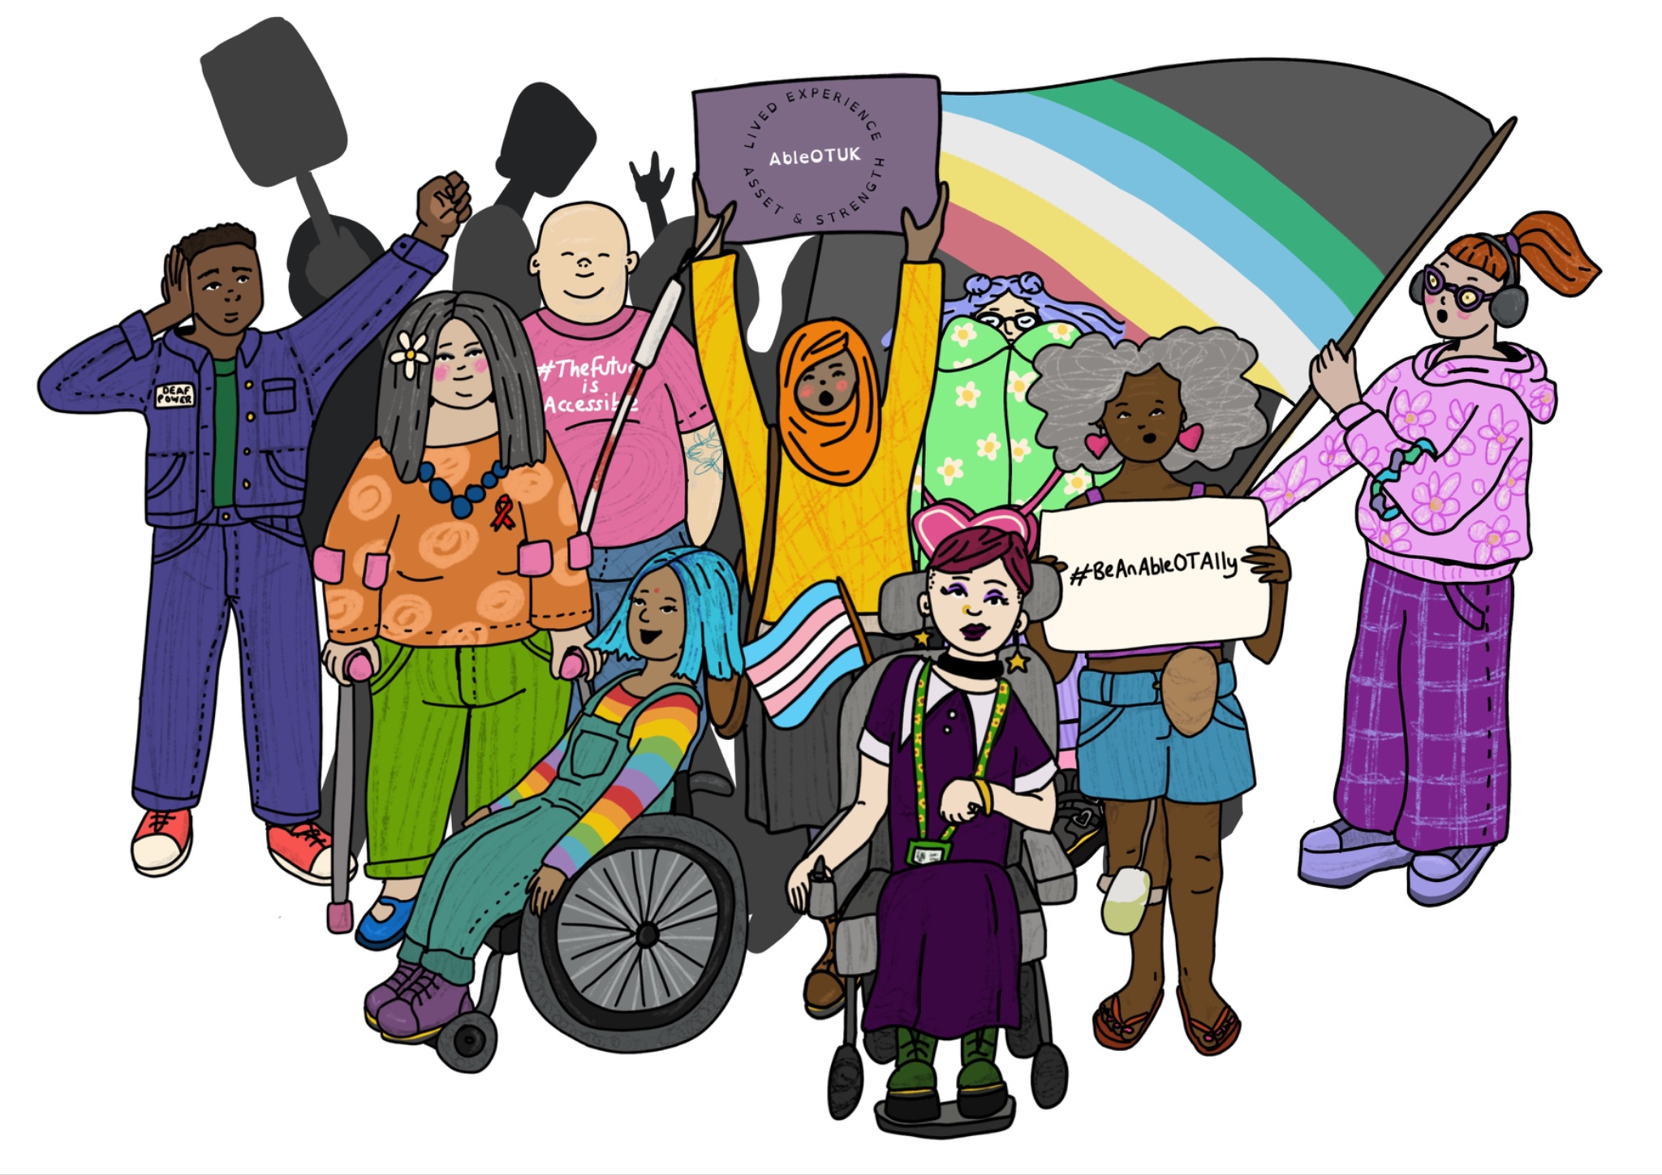
Celebration and Learning Event - Welcome
Artwork by @makedaisychains / Hannah Daisy

Slide 2
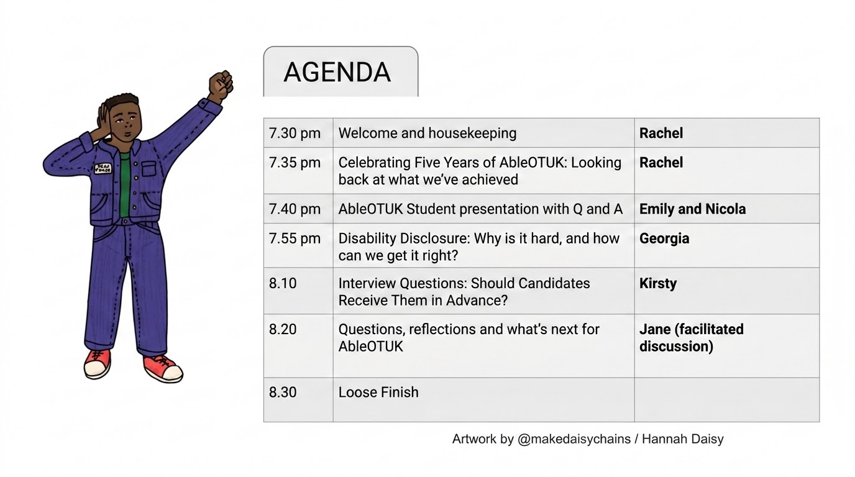
Notes:
Rachel
Good evening everyone, and welcome to our AbleOTUK 5th Birthday Celebration.
It's wonderful to see so many of you joining us this evening. Whether you've been with AbleOTUK since we launched on 27th July 2021 or have only recently become part of our community, thank you for taking the time to celebrate with us.
I’m Rachel one of the founding members of AbleOTUK, you will hear from others later in the evening.
Tonight is an opportunity to look back at everything we've achieved together over the past five years, hear from some fantastic speakers, celebrate the impact of lived experience within occupational therapy and think about where AbleOTUK goes next.
Before we begin, just a few housekeeping points.
The session will last for approximately one hour and will finish at around 8.30 pm.
The meeting is being recorded so that those who are unable to join us can watch it afterwards on the AbleOTUK YouTube channel.
Live captions are available throughout the event to help make the session as accessible as possible.
We will send out a copy of the slides to everyone who has joined use tonight and the membership mailing list.
Please keep yourself on mute unless you're invited to speak. You do not need to keep your camera on, partlicity if you do not want to feature in the recording. We'd also encourage you to use the chat throughout the evening to share your thoughts, reflections and celebrate alongside everyone else.
We'll have time for questions and discussion towards the end of the session,
Finally, we'd like to say thank you. AbleOTUK has always been a community built by its members. Everything we celebrate tonight has been made possible by people giving their time, sharing their lived experience and supporting one another. We really appreciate you being here to celebrate this milestone with us.
With that, let's get started by looking back at what AbleOTUK has achieved over the past five years.

Slide 3
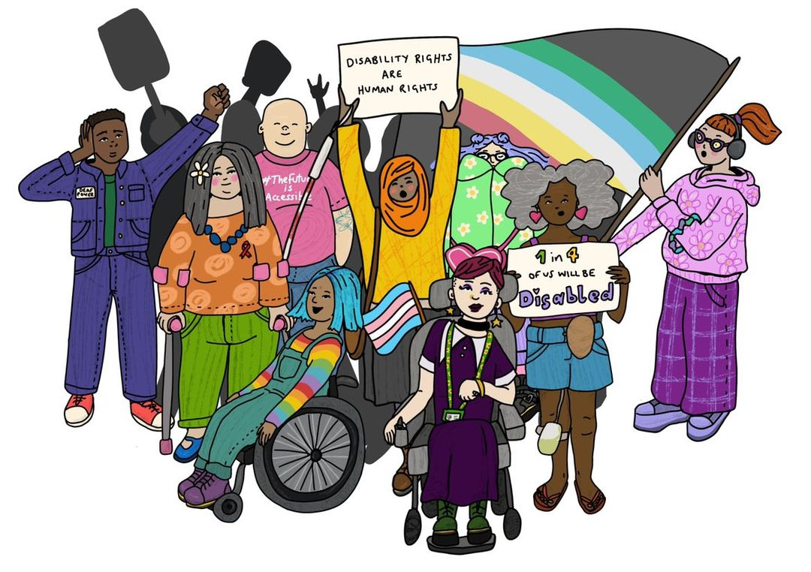
Launched on 27 July 2021 during Disability Pride Month.
Each July we celebrate both Disability Pride Month and AbleOTUK's continuing contribution to a more inclusive occupational therapy profession.
Artwork by @makedaisychains / Hannah Daisy
Notes:
Rachel
Five years ago, AbleOTUK was created because many of us shared similar experiences within the occupational therapy profession.
We had experienced barriers, discrimination and ableism. We had seen colleagues and students feeling isolated, unsupported or questioning whether they belonged in occupational therapy because of disability, long-term health conditions or neurodiversity.
At the same time, we recognised something else.
These experiences were not just individual stories. They reflected wider issues across our profession that needed to be talked about and challenged.
So, rather than waiting for change to happen, we came together to create AbleOTUK.
Our aim was to create a welcoming community where occupational therapists, occupational therapy assistants, students, educators and researchers with lived experience could connect, support one another and know they were not alone.
But we also wanted to be a voice for change.
To challenge discrimination and ableism wherever we found it.
To work alongside the profession to improve accessibility and inclusion.
And to ensure that the voices of disabled occupational therapists, people with long-term health conditions and neurodivergent colleagues were heard and valued.
Five years later, we still have work to do, but tonight is an opportunity to celebrate just how far we've come together.
You'll notice this beautiful artwork featured throughout our presentation and in our newsletter. It was created by Hannah Daisy, one of AbleOTUK's members and volunteers. Hannah's illustrations have become well known for celebrating disability, neurodiversity and self-acceptance, and we are delighted to feature her work as part of our celebration. You can see more of her artwork by following her on Instagram: @makedaisychains.

Slide 4
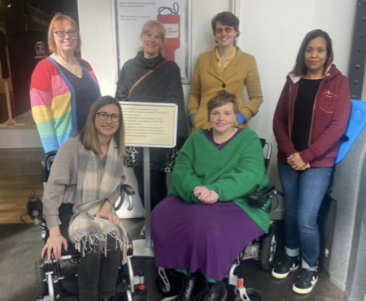
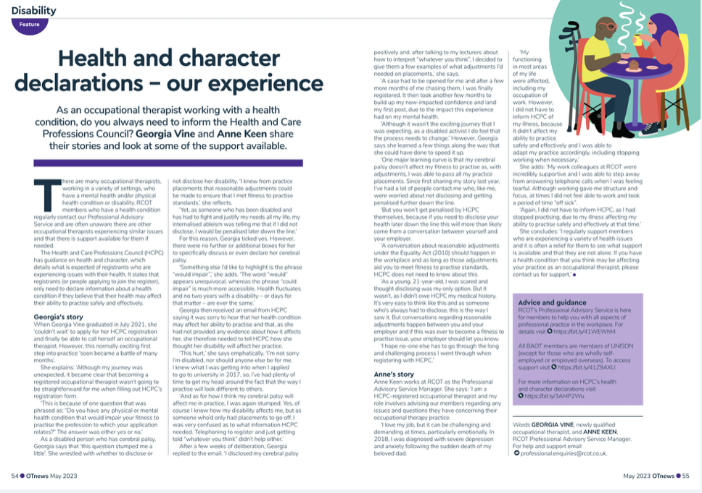
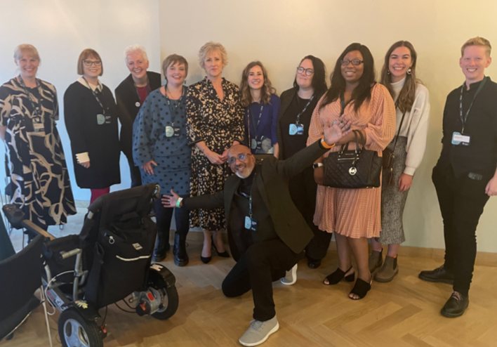
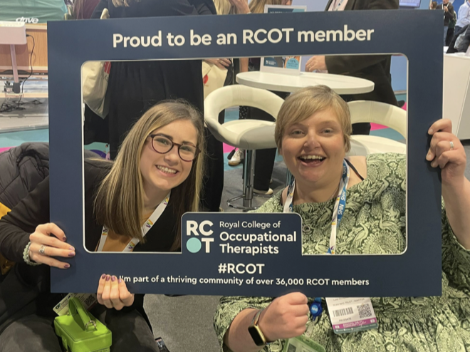
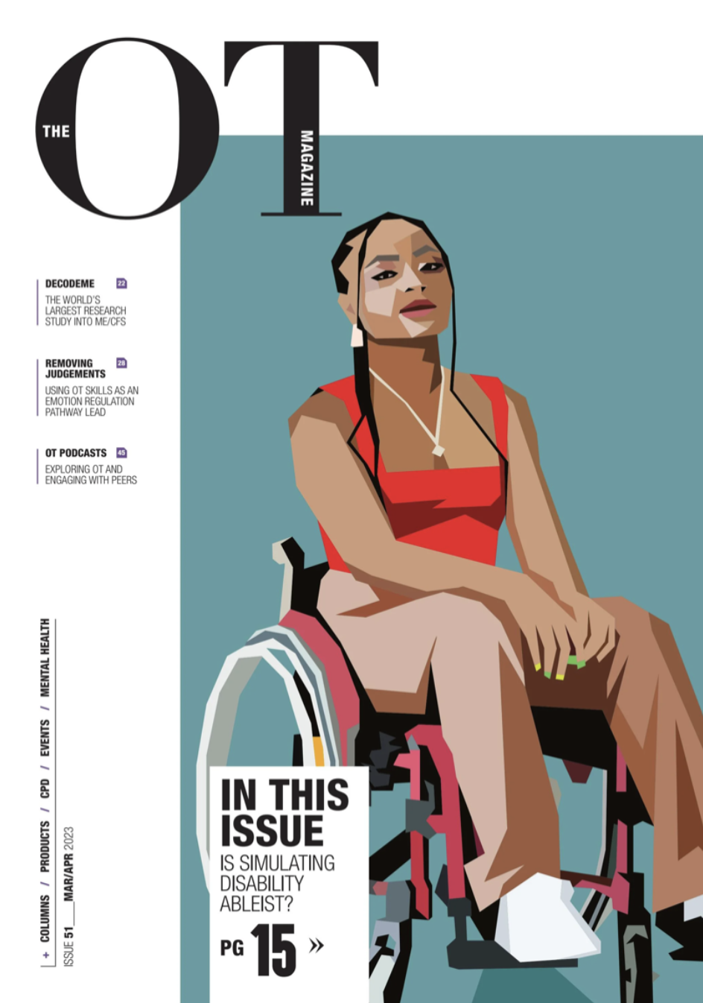
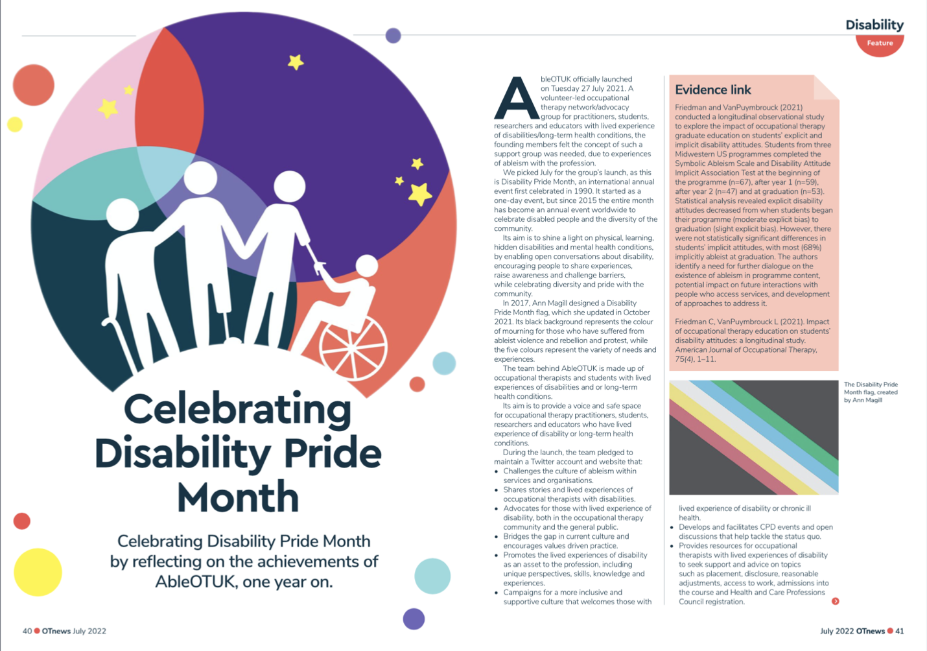
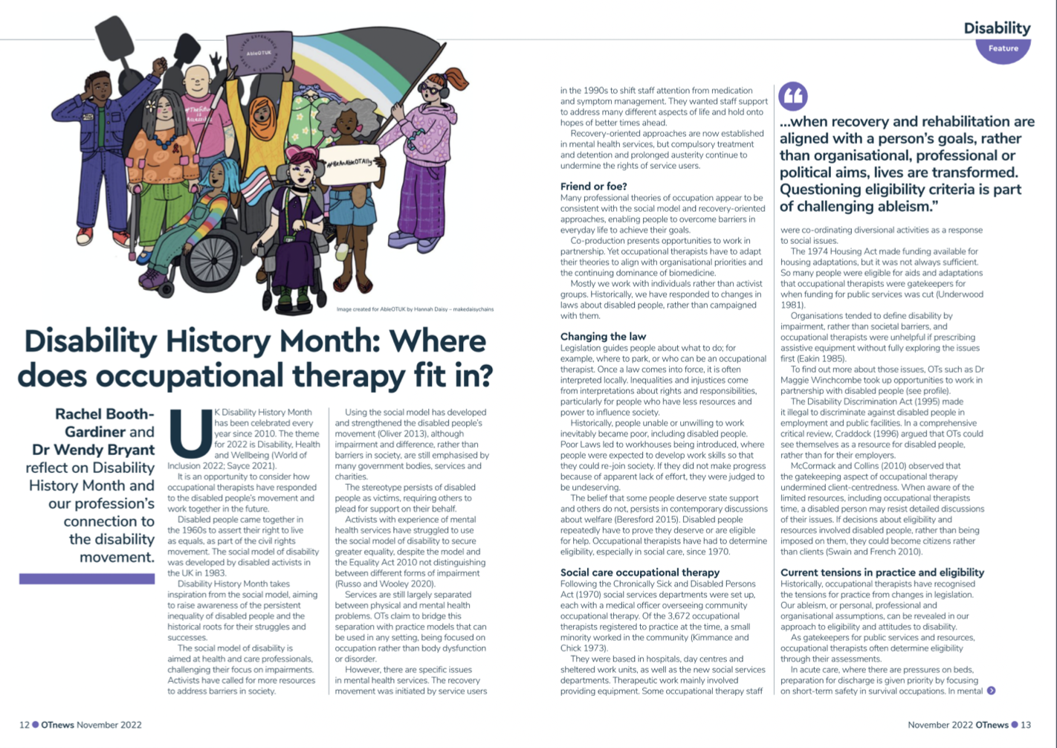
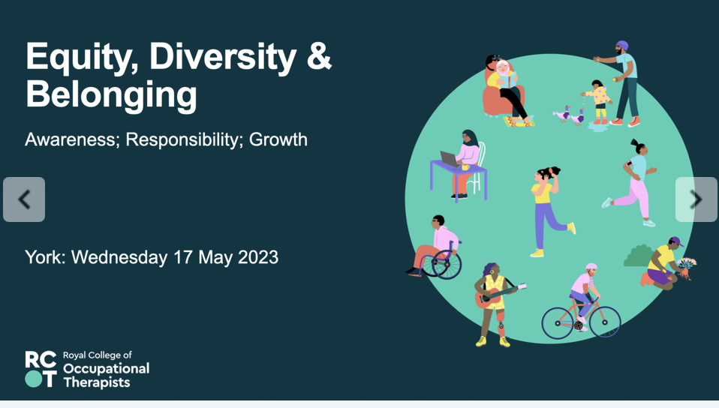
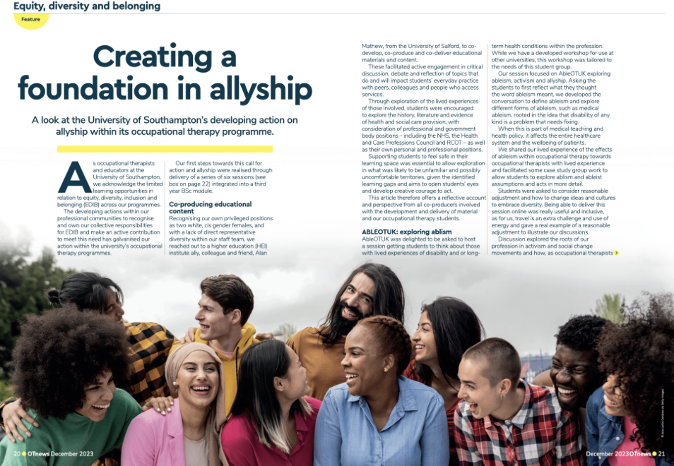
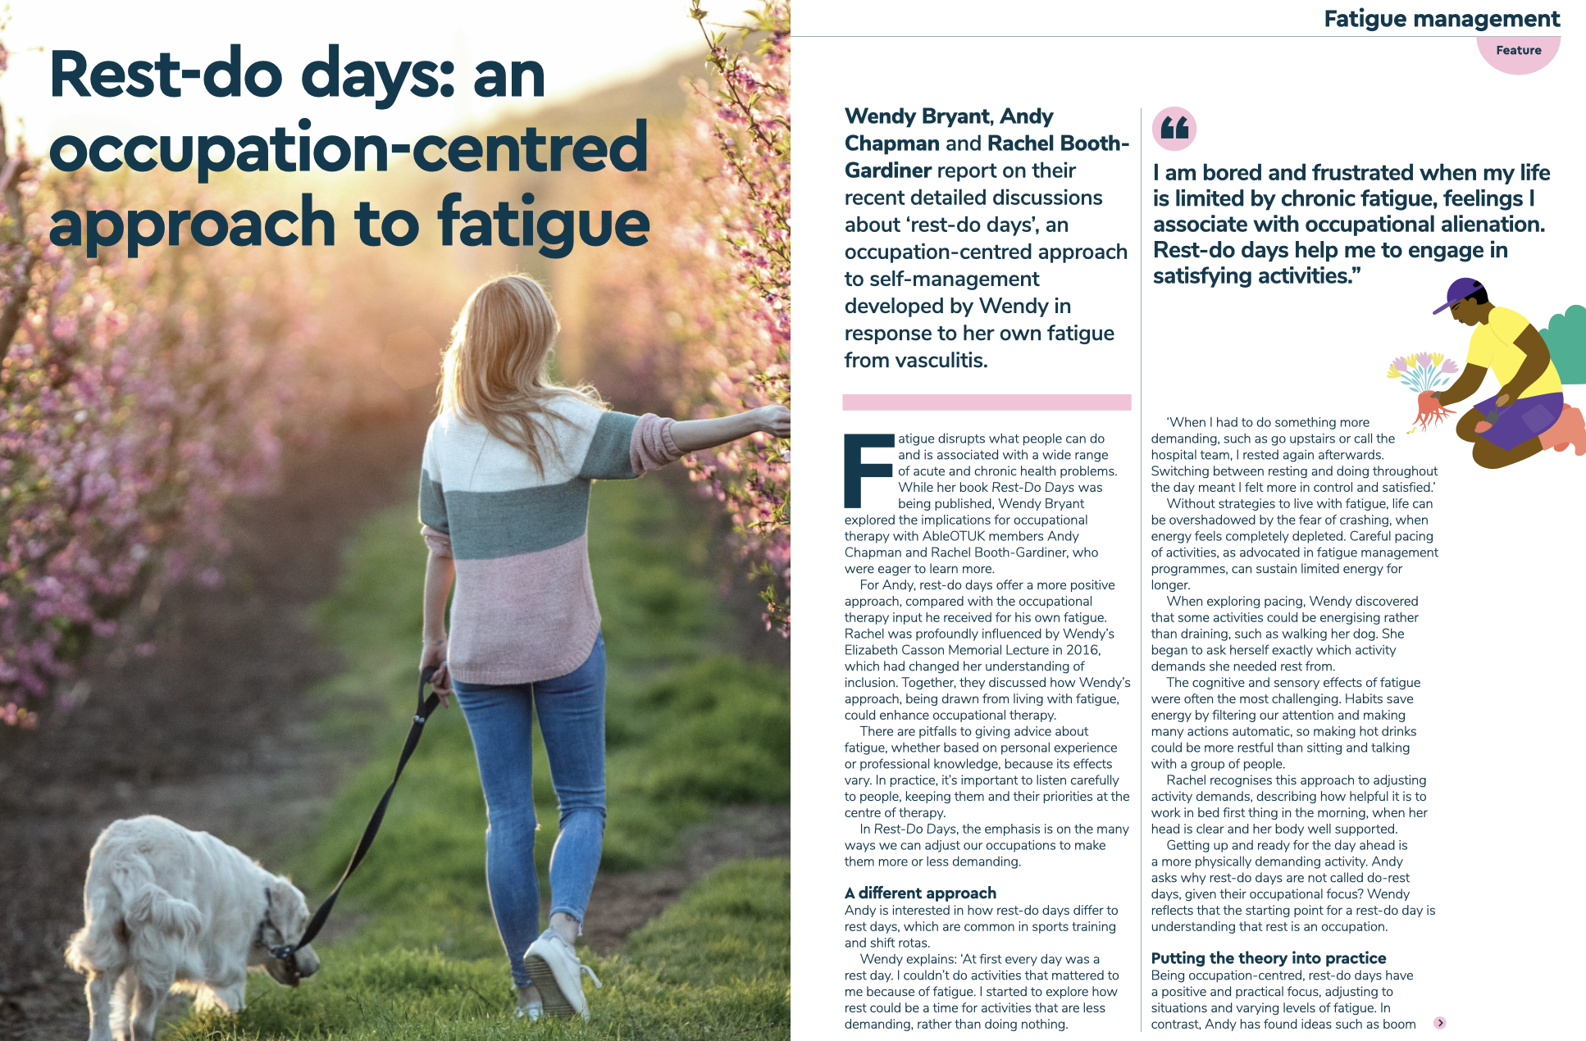
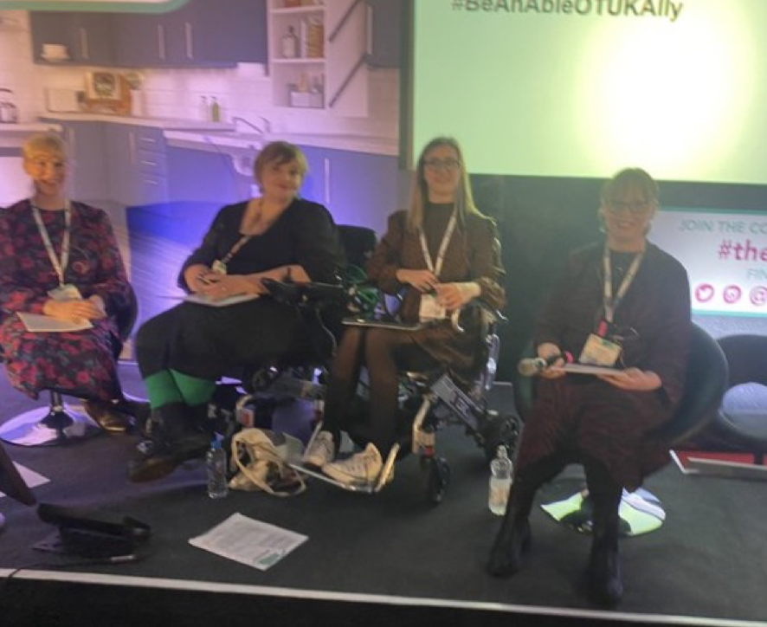

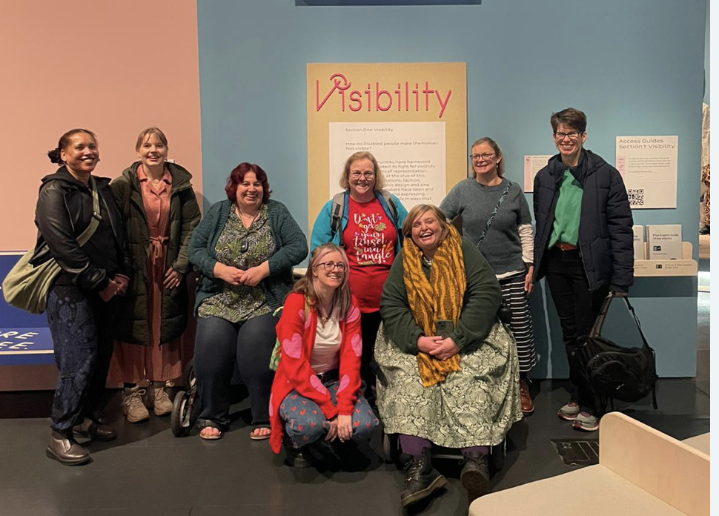
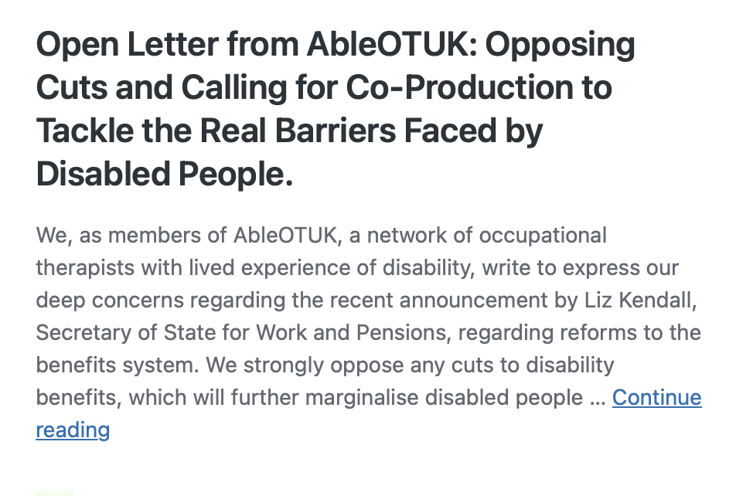
Notes:
Over the past five years, we have achieved far more than we ever imagined when AbleOTUK first began.
Together, we have shared our lived experiences through articles, blogs, newsletters and social media, bringing the voices of disabled occupational therapists, people with long-term health conditions and neurodivergent colleagues into professional conversations and encouraging others to reflect on their own practice.
We have presented at national conferences, including the RCOT Conference and The OT Show, delivered university teaching, hosted webinars, OTalk discussions, Disability Pride Month events and learning sessions, creating opportunities for occupational therapists to learn directly from colleagues with lived experience.
Alongside this, we have led and contributed to campaigns that have challenged discrimination and ableism within occupational therapy. We have spoken about disability disclosure, reasonable adjustments, accessibility, disability simulation, anti ableist practice, the value of lived experience and the impact of changes to Personal Independence Payment. We have also responded to national consultations and worked to ensure the voices of disabled occupational therapists, people with long term health conditions and neurodivergent colleagues are represented.
Much of this work has been strengthened through collaboration with colleagues from other equality, diversity and inclusion networks and organisations. By working together, we have recognised that disability does not exist in isolation. People's experiences are shaped by the intersection of disability with other aspects of identity, and these intersecting experiences influence accessibility, inclusion and belonging within the profession and wider society.
One of our proudest achievements is how AbleOTUK is now recognised across the profession. Over the past five years, we have built strong relationships with organisations, including the Royal College of Occupational Therapist, and health care professional council (HCPC) RCOT now regularly comes to us for our views on issues relating to disability, accessibility and inclusion, asking us to contribute to consultations, guidance, campaigns and wider professional discussions. This demonstrates how far we have come and ensures lived experience is helping to shape the future of occupational therapy.
Alongside all of this, we have continued to provide our monthly peer support network, creating a welcoming space where occupational therapists and students can connect, share experiences, support one another and realise they are not alone. While our publications and presentations are important, it is often these conversations, the friendships formed and the confidence people gain that have the greatest impact.
Looking back, we are not just proud of the events we have delivered, the articles we have published or the campaigns we have led. We are proud that, together, we have influenced our profession, challenged barriers where we have found them and created a community where people know they belong. That is something worth celebrating, and it gives us a strong foundation for the next five years.

Slide 5
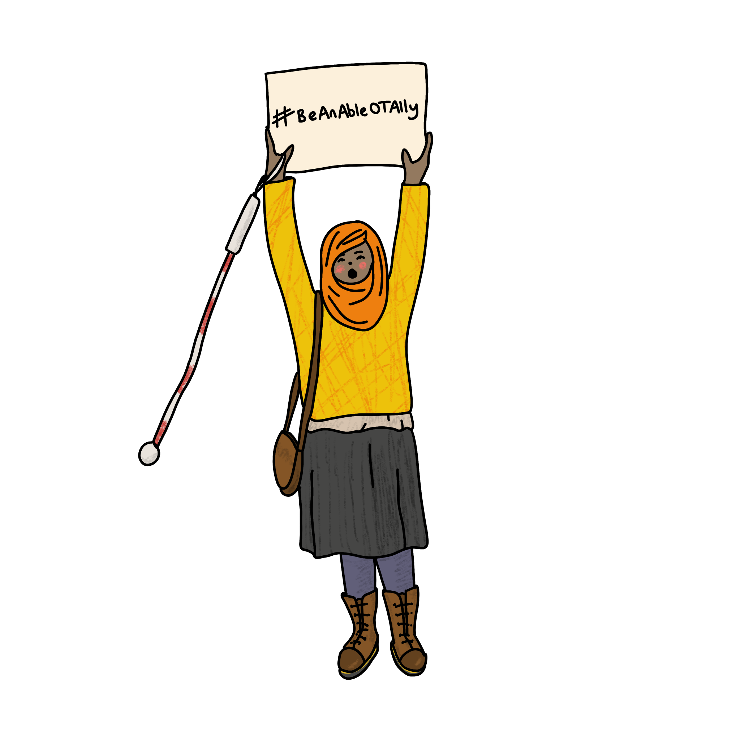
Becoming an Active AbleOTUK Member
Active members help to:
Plan events, campaigns and future projects.
Support our monthly peer support groups.
Contribute to our website and newsletters.
Share ideas through our Active Members WhatsApp group.
Help shape the future of AbleOTUK.
Before you sign up
This is a voluntary role with no payment.
Please only sign up if you have the time to actively engage
Artwork by @makedaisychains
Notes:
As we've reflected tonight, everything AbleOTUK has achieved over the past five years has been made possible by volunteers. None of us are paid for the work we do. We all give our time alongside our jobs, studies, health and family commitments because we believe in what AbleOTUK stands for.
If you've been inspired by what you've heard this evening and would like to help shape the future of AbleOTUK, we'd love to welcome you as an active member.
Being an active member means becoming part of the team that helps keep AbleOTUK running. That might involve planning events, contributing to our website or monthly newsletter, supporting our peer support groups, responding to consultations or helping us develop new projects and campaigns. We also have an Active Members WhatsApp group where we share ideas, plan activities and keep in touch.
We do ask that you only sign up if you have the time to actively engage. We completely understand that everyone's circumstances are different, and we want volunteering to be enjoyable and sustainable for everyone.
It's also important to say that you do not need to become an active member to be part of AbleOTUK. Many people simply enjoy receiving our monthly newsletter, attending events and being part of our community, and that is equally valued.
If becoming an active member is something you'd be interested in, we'll pop the sign up link in the chat. We'd love to have you join us as we begin the next chapter of AbleOTUK.

Slide 6
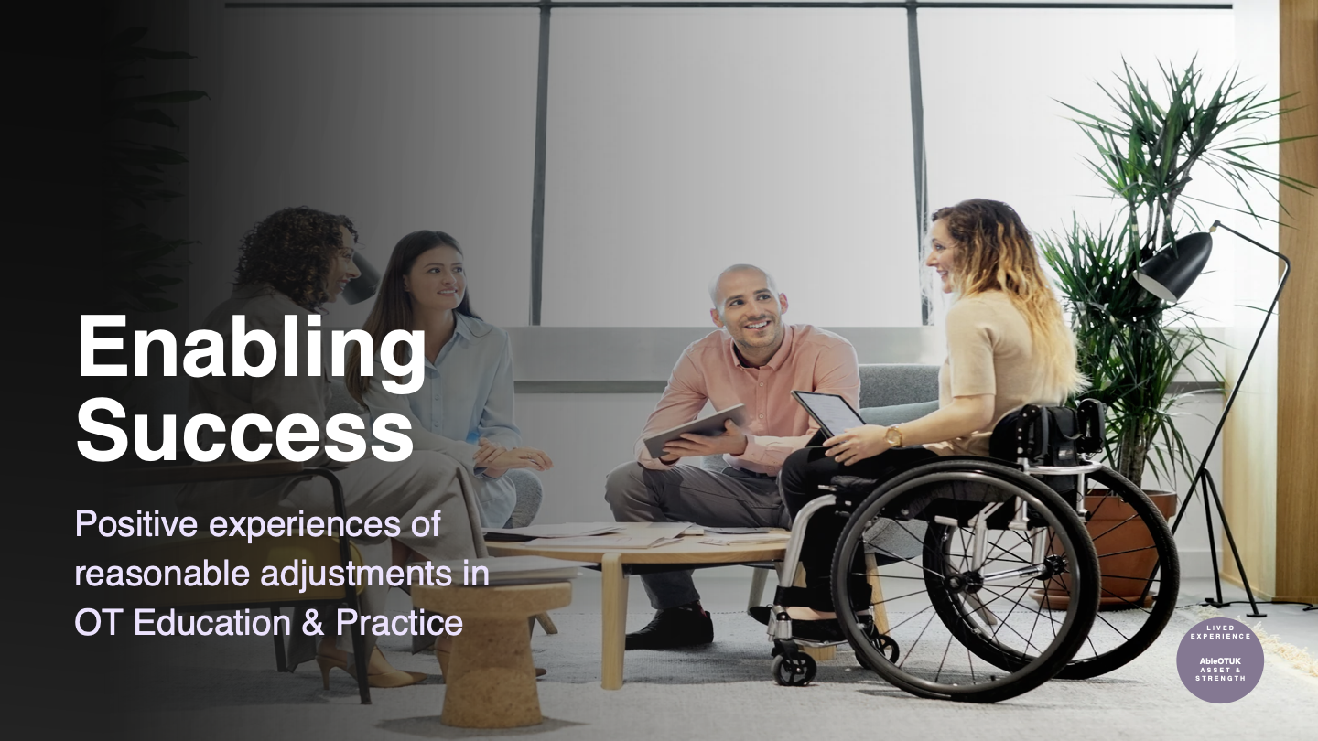
AbleOTUK Student presentation Emily and Nichola
Insert powerpoint here

Slide 7
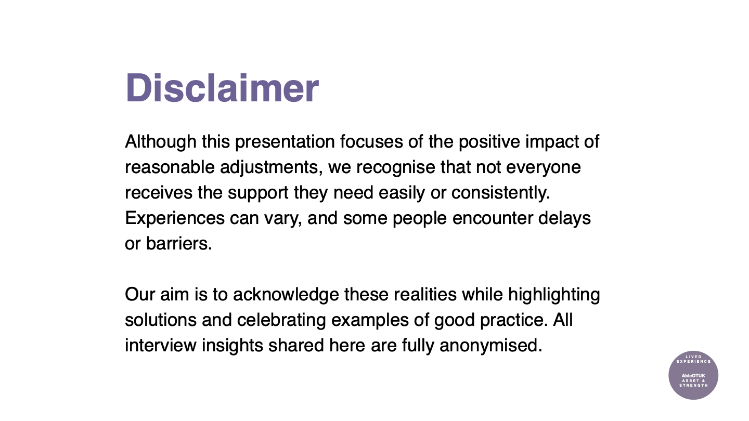

Slide 8
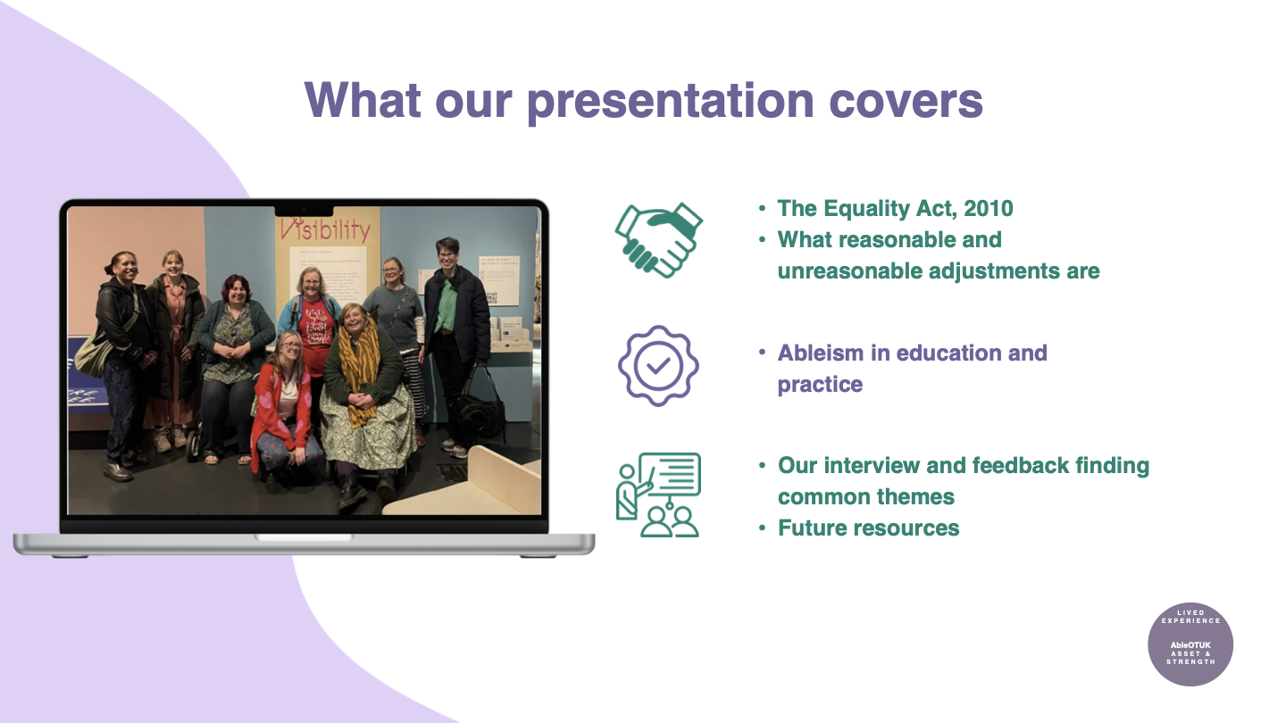

Slide 9
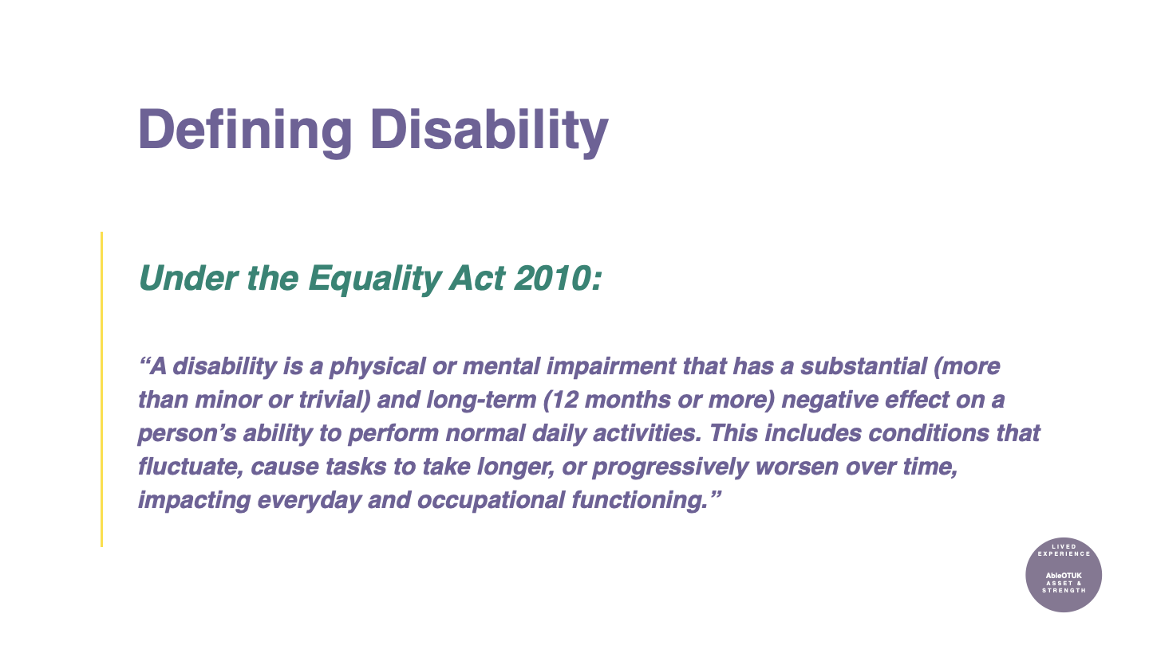

Slide 10
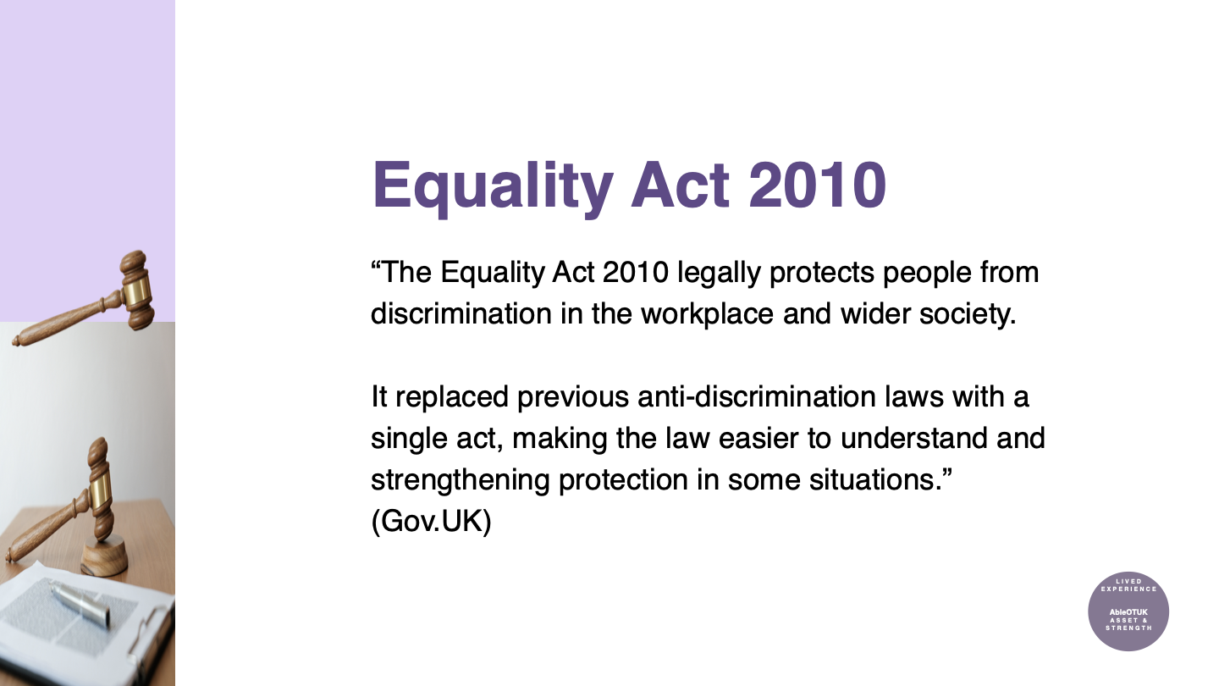

Slide 11
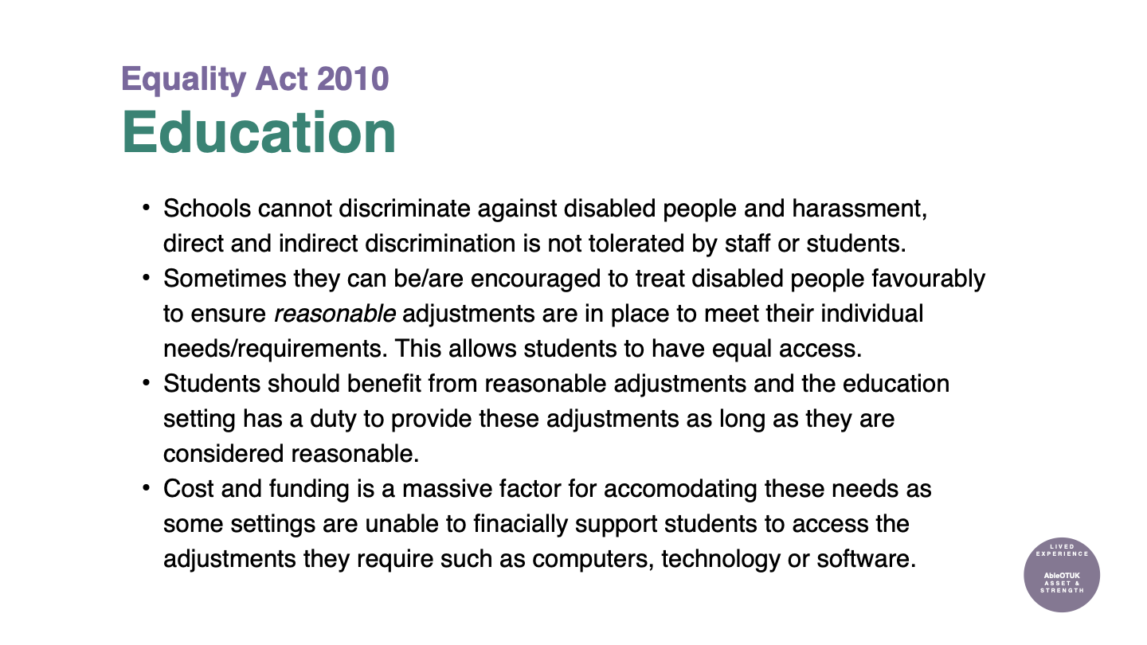

Slide 12
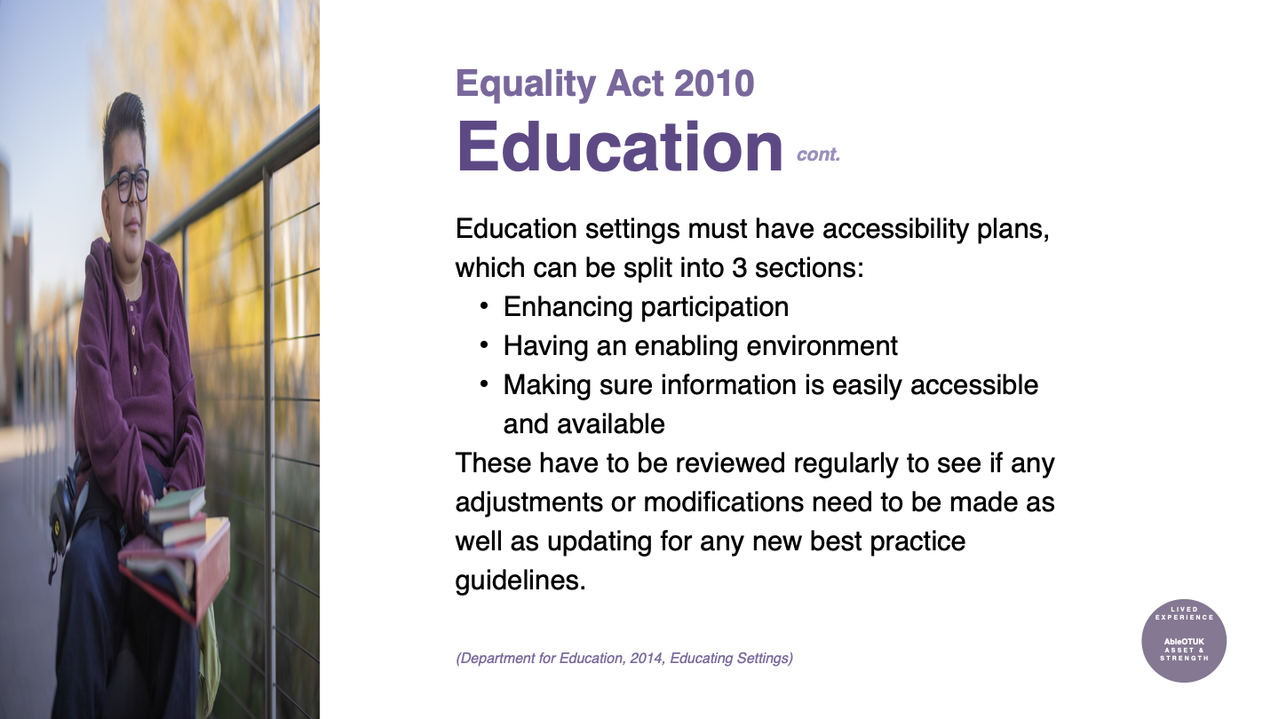

Slide 13
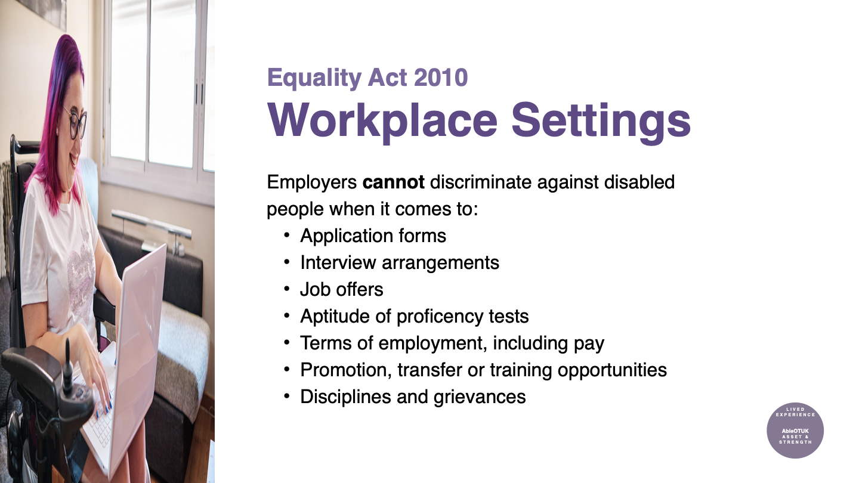

Slide 14
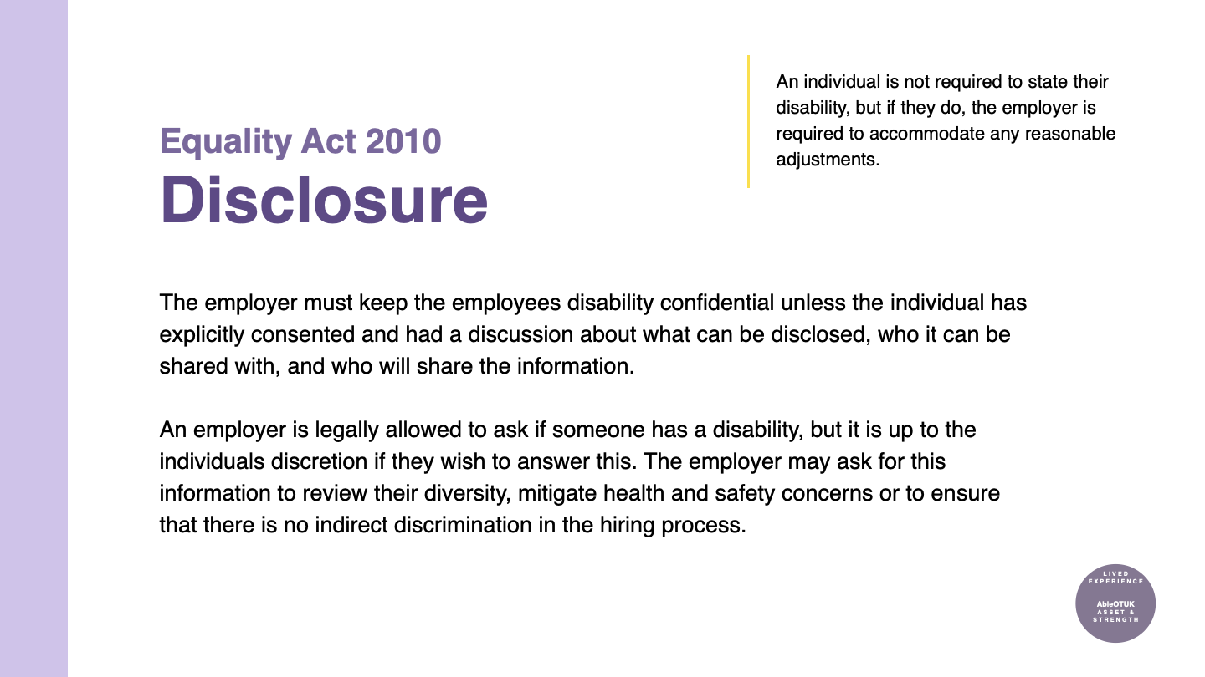

Slide 15
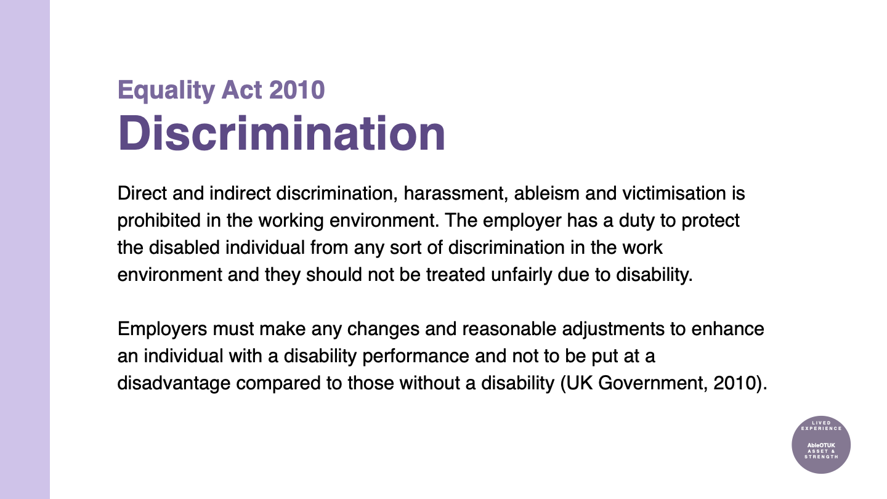

Slide 16
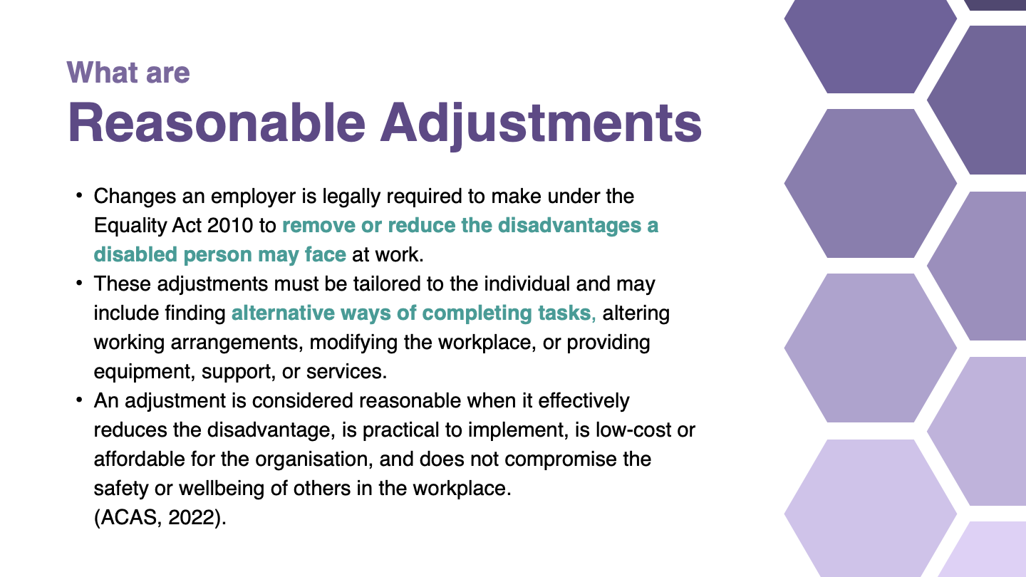

Slide 17
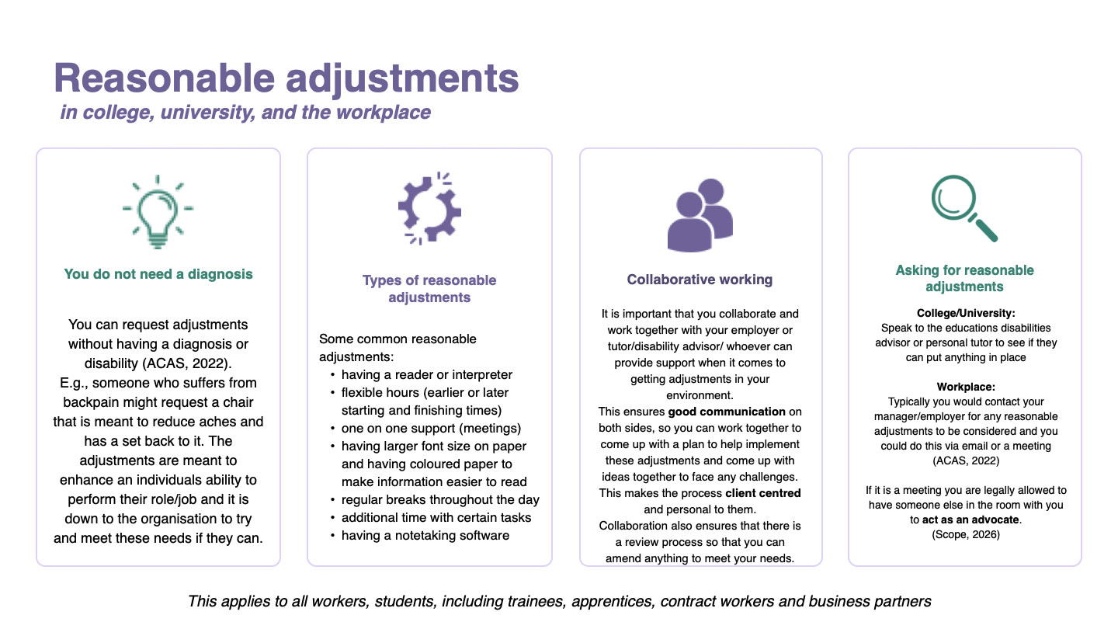

Slide 18
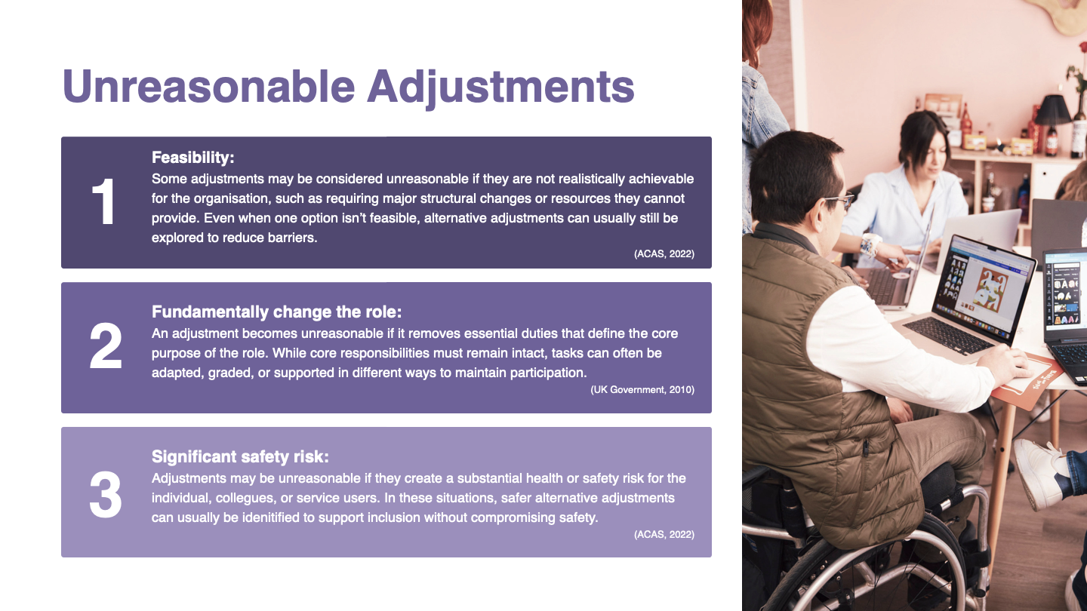

Slide 19
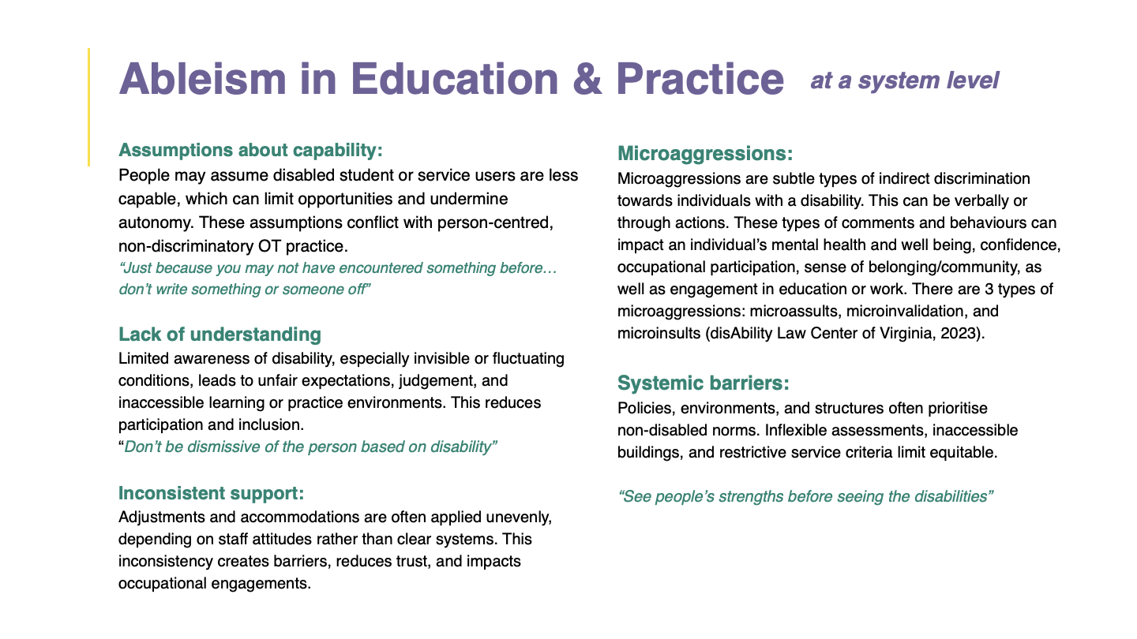

Slide 20
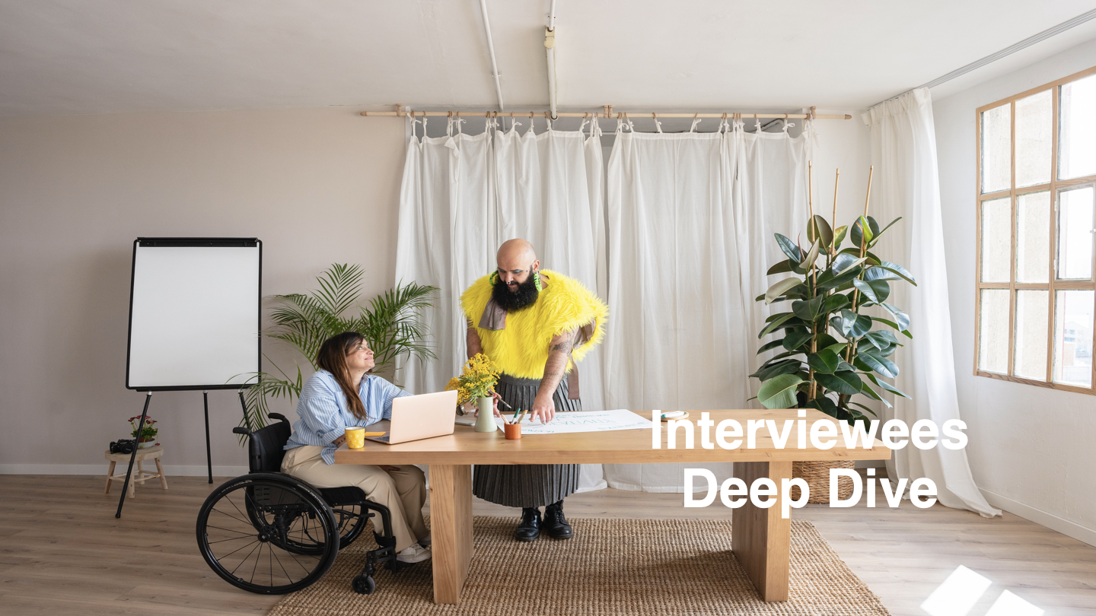

Slide 21
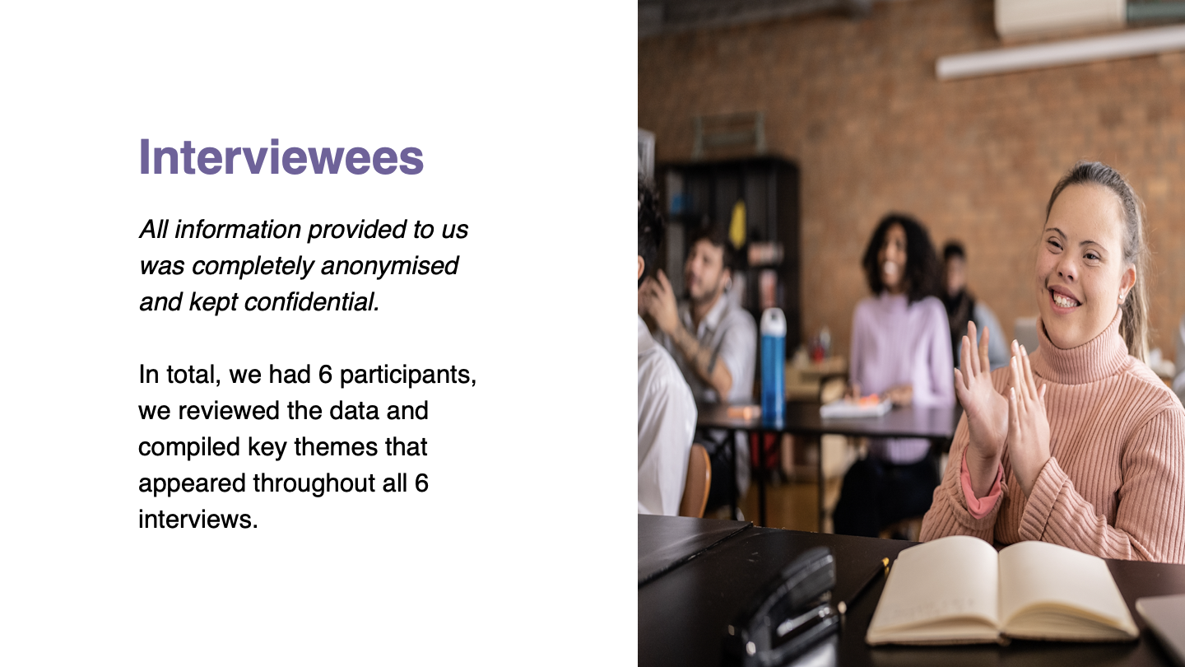

Slide 22
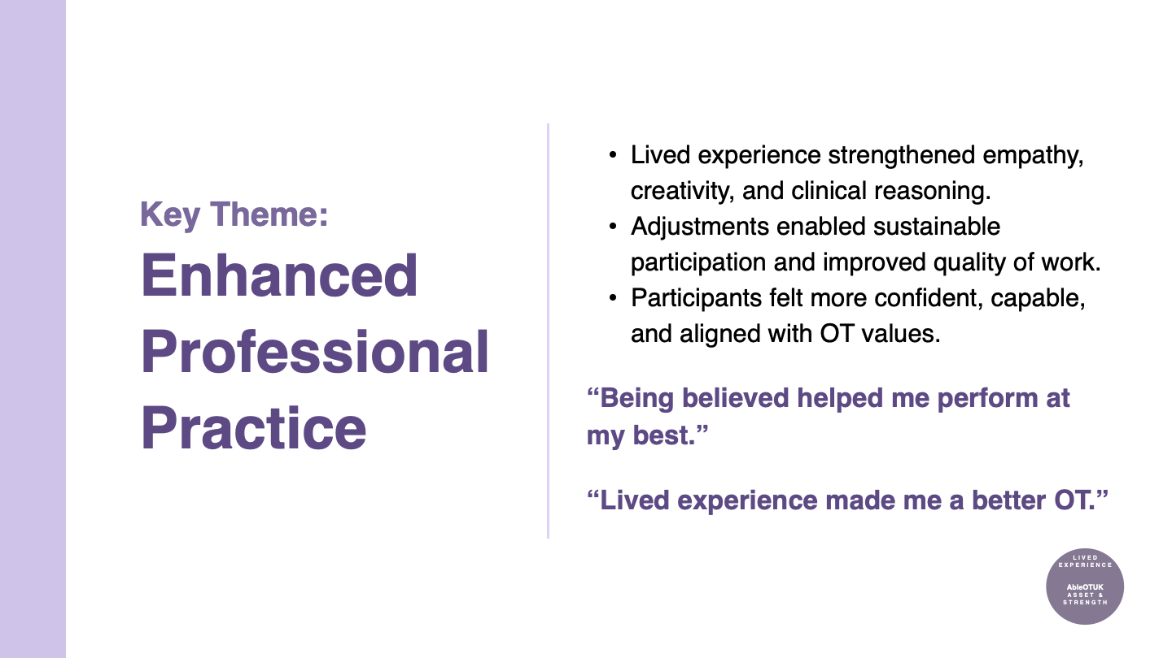

Slide 23
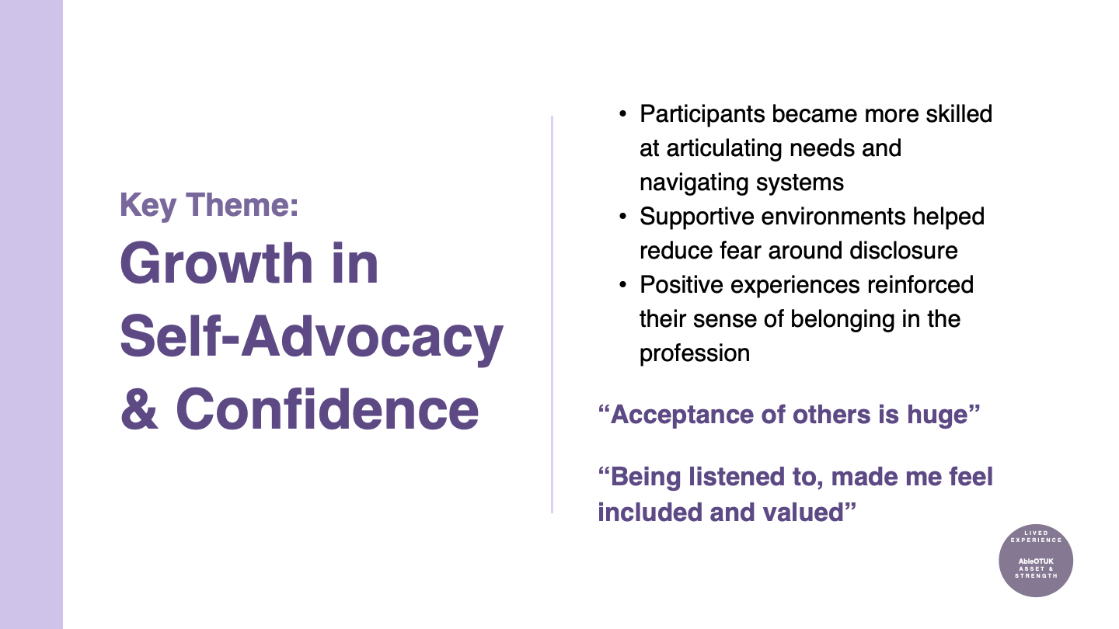

Slide 24
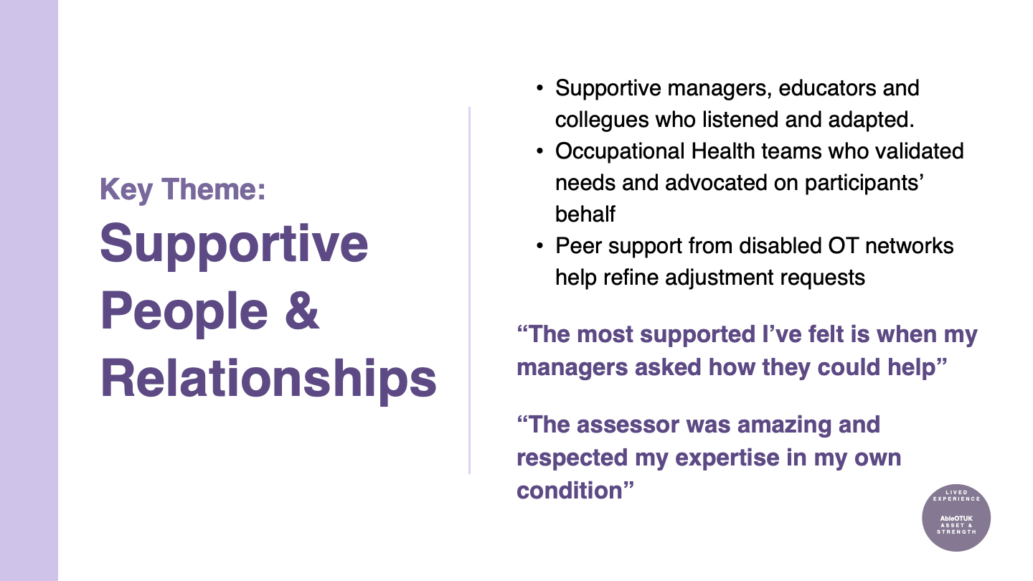

Slide 25
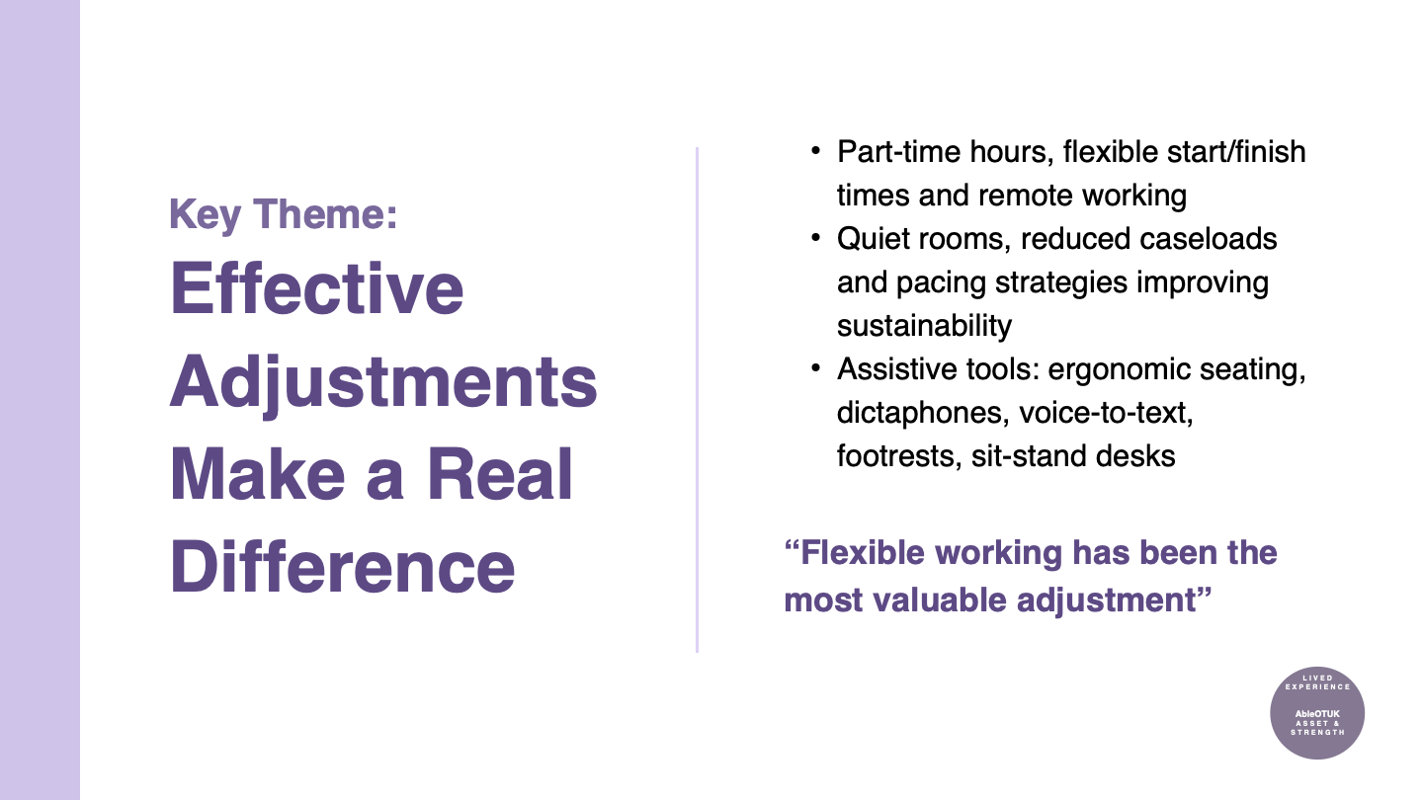

Slide 26
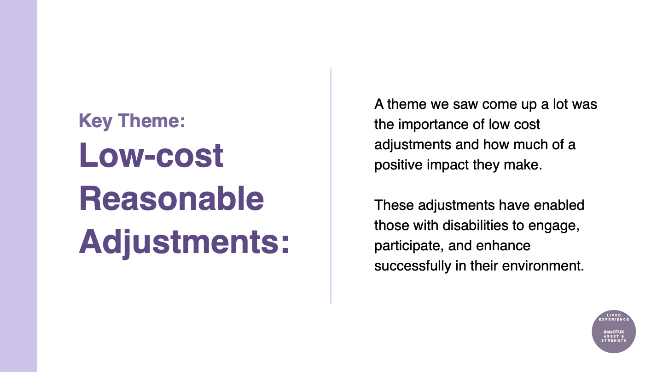

Slide 27
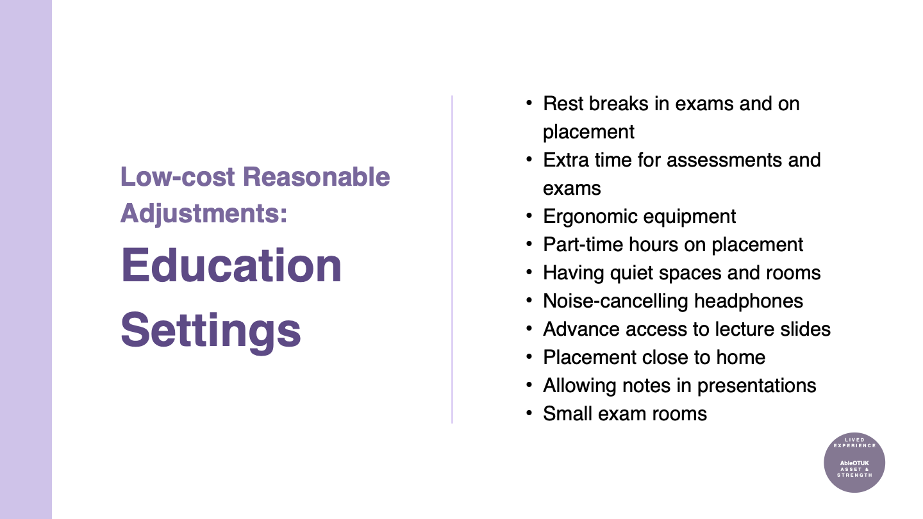

Slide 28
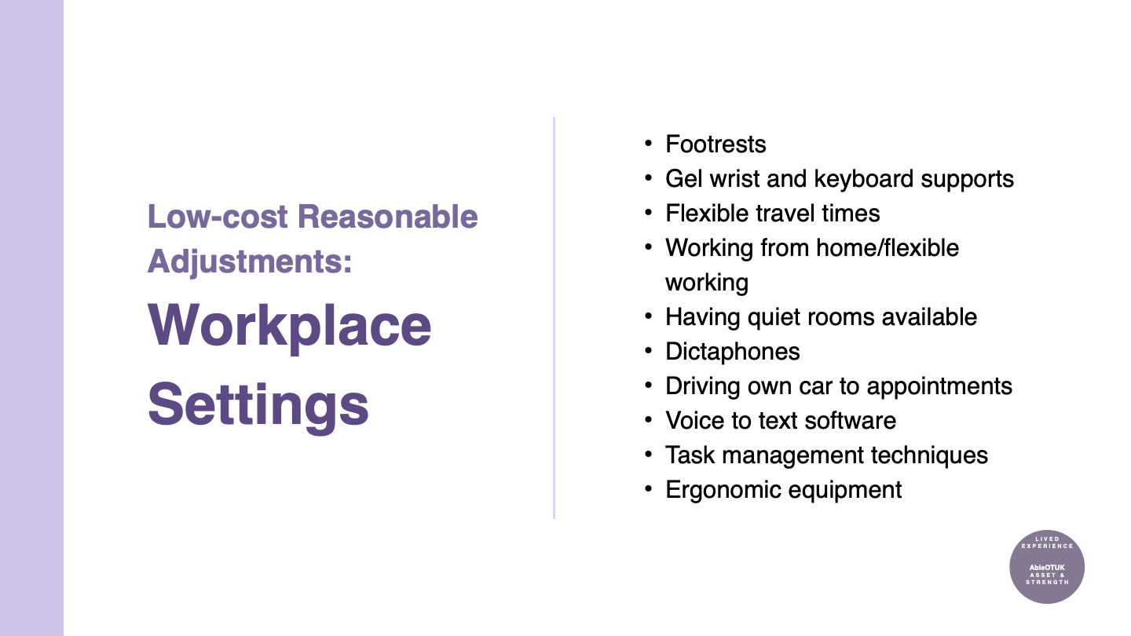

Slide 29
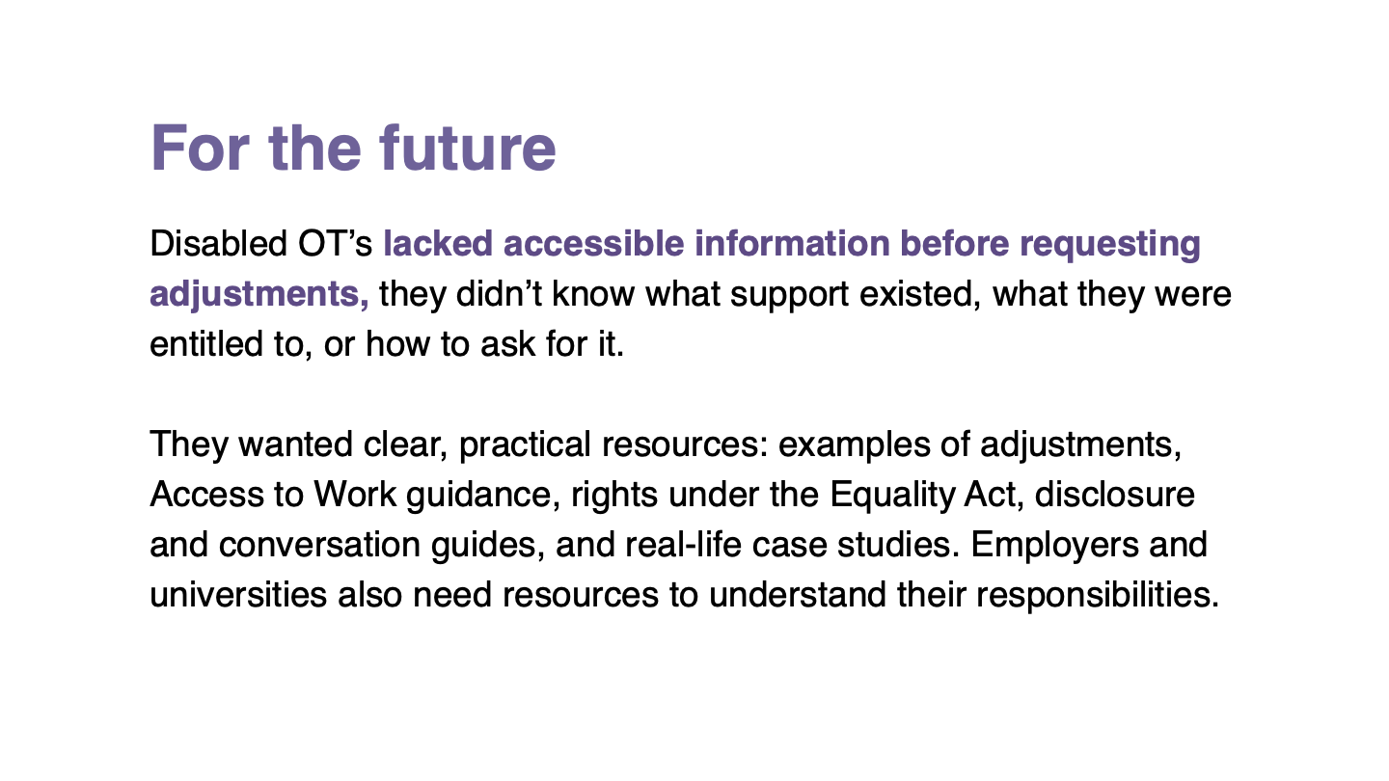

Slide 30
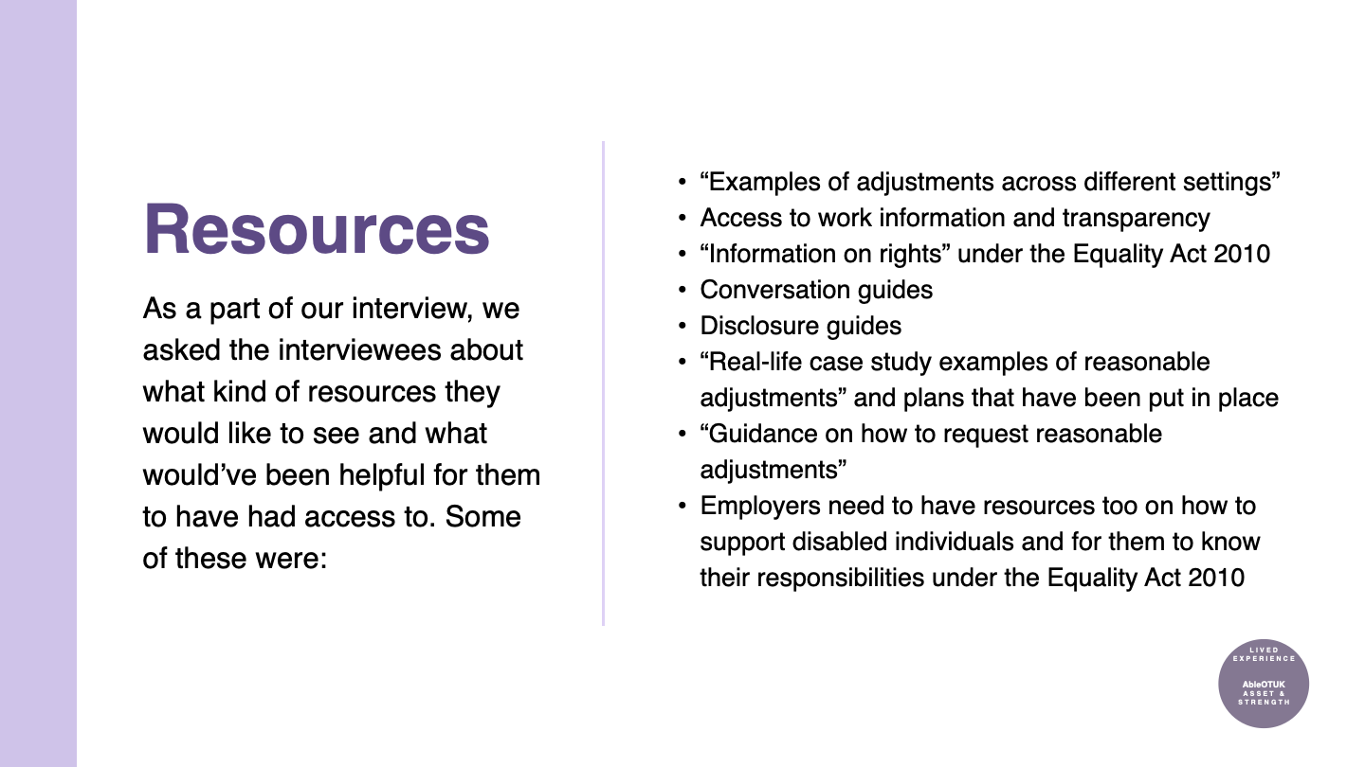

Slide 31
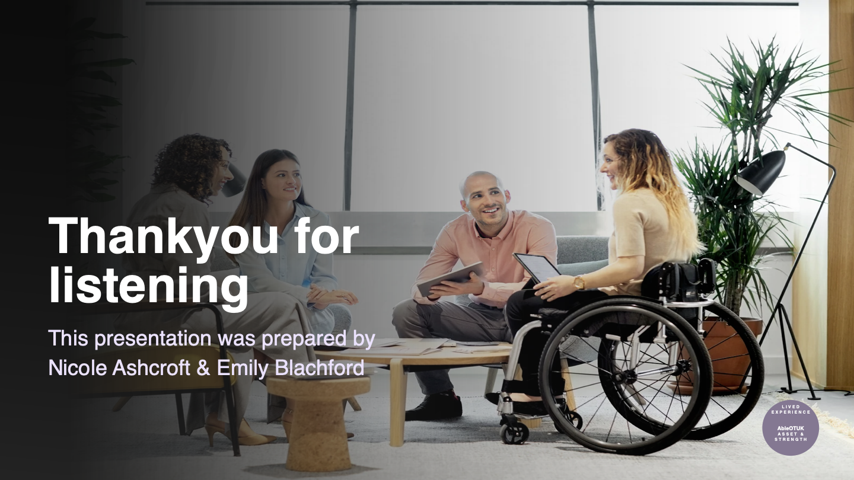

Slide 32
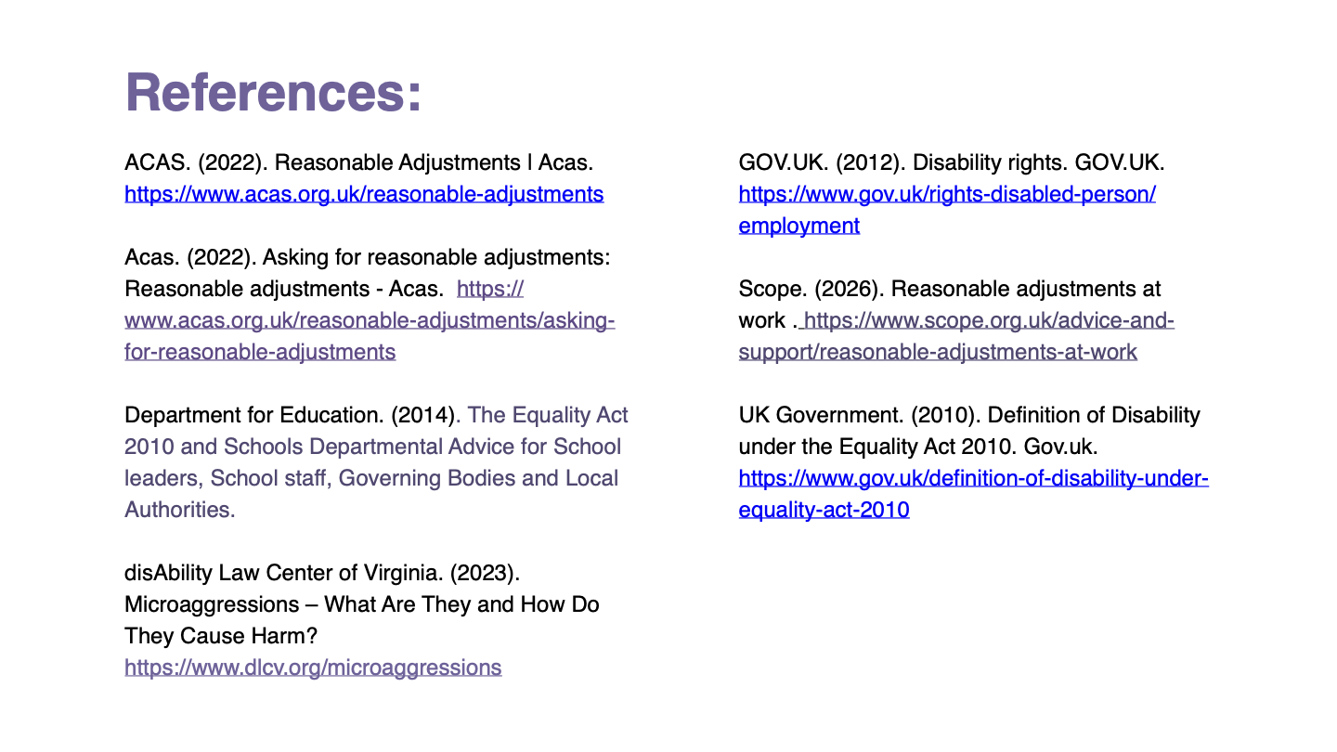

Slide 33
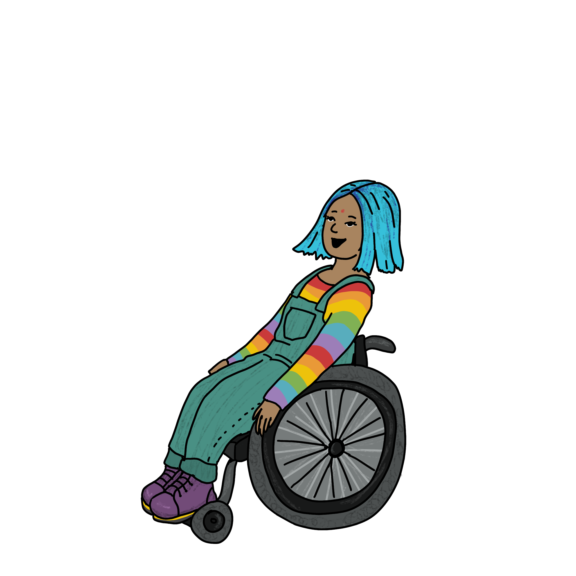
Disability Disclosure: Why is it hard, and how can we get it right?
Artwork by @makedaisychains

Slide 34
The current climate
29.4 % of new OT learners in the UK have a disability or long-term health condition​
10% have specific learning disabilities and 8% have a mental health condition. ​​
11% of 7,320 occupational therapists reported a disability (HCPC, 2021)​​
Principle 3 of the AHP Principles of Practice-based learning states that ‘Practice-based learning environments must be inclusive and welcoming to all’

Slide 35
The Equality Act (2010)
Section 20, of the Equality Act (2010) imposes a duty for employers to facilitate reasonable adjustments when a disabled persons practice is disadvantaged compared to a non-disabled person’s practice.

Slide 36
But before reasonable adjustments can be made disclosure must take place

Slide 37
The gap
Reflections highlight additional challenges faced on placement with the needs of disabled learners not being recognised (Hamell, 2022)
The drawn-out processes such as institutional barriers and attitudinal barriers from placement educators themselves (Adefila et al, 2020), creates negativity around disclosing meaning a supportive environment must be provided

Slide 38
Reasons to disclosure
Enables reasonable adjustment​
The student is in a better position to demonstrate their competencies​
Encourages a clearer understanding of the students disability and requirements​
Encourages greater communication between student, Uni and placement provider​
Likely to reduce stress and anxiety before placement.​
Practitioners providing placements will have an increased awareness of requirements and may benefit from adjustments made for the student.

Slide 39
Reasons not to disclose
Fear of being judged ​
Fear of not being believed ​
Previous negative experiences resulting in internalised ableism​
May not feel or think they need to disclose​
Can't predict what challenges they will come across.

Slide 40
What is positive disclosure?
Positive disclosure is creating a culture and environment whereby students feel empowered to disclose is essential to encourage positive disclosure. To reduce the differential attainment gap for disabled learners, it is our responsibility to proactively address learning needs and create inclusive environments to encourage this. ​​
This is a process of continuous ongoing conversations and is not just a tick box. ​​
It is a collaborative approach between students, personal tutees, disability coordinators and (if applicable) placement educators. ​

Slide 41
Whose responsibility is it? (placement perspective)
In many higher education institutions (HEI's), learners first must disclose their disabilities before they can access accommodations (Sapir & Banai, 2023)
The literature suggests that there are many reasons why students may not disclose (Lindsay et al., 2018) and decisions to disclose can be further compounded by intersecting identities (Ngo & Sundell, 2023)​
Universities have the responsibility to create supportive and inclusive environments that actively promote positive disclosure (McKinney & Swartz, 2022)​​
​

Slide 42
Conversation starters
Are there any reasonable adjustments we could explore to support you on placement?
What could we do as placement educators to support success in your placement? ​
Can you think of anything that might impact your placement experience?
What support have you been given on previous placements that have worked for?
I understand that this is a process we might not get this right the first time but we will keep discussing

Slide 43
Placement support plans
Placement support plans should be made at the beginning of any course with learners having access to this to share with placement educators.
Placement support plans must be regularly updated as what a learner may pre-empt they need before going on placement may be less or different to what they need once experiencing placement. Therefore, this plan needs to be regularly reviewed and updated. ​
Placement support plans can then be used as a tool throughout not just their time as a learners but to help them build a record of help accommodations to aid their career.​
​
​

Slide 44
References
Adefila, A., Brouughan, C., Phimister, D. and Opie, J. (2020). 'Developing an autonomous-support culture in higher education for disabled students', Disability and Health Journal 13, 3, 1-6 https://doi.org/10.1016/j.dhjo.2020.100890 ​
​
Charted Society of Physiotherapists & Royal College of Occupational Therapists. (2023). AHP principles of practice-based learning: Working together to develop our future workforce. ​
​
Equality Act 2010. Section 20. https://www.legislation.gov.uk/ukpga/2010/15/section/20 ​​
​
Hammell, K. W. (2022). ‘A call to resist occupational therapy’s promotion of ableism’, Scandinavian Journal of Occupational Therapy. 1-13. https://doi.org/10.1080/11038128.2022.2130821​
​
Health Care Professions Council. (2021) HCPC Diversity Data Report 2021: occupational therapists. https://www.hcpc-uk.org/globalassets/resources/factsheets/hcpc-diversity-data-2021-factsheet--occupational-therapists.pdf​
​
Lindsay, S., Cagliostro, E. and Carafa, G. (2018). 'A Systematic Review of Barriers and Facilitators of Disability Disclosure and Accommodations for Youth in Post-Secondary Education', International Journal of Disability, Development and Education 65, 5, pp 526-556. https://doi.org/10.1080/1034912X.2018.1430352 ​
​
McKinney, E.L. & Swartz, L. 2022, "Integration into higher education: experiences of disabled students in South Africa", Studies in higher education (Dorchester-on-Thames), 47, 2, 367-377. ​
​
Ngo, F. & Sundell, D.M. (2023). 'Inequities at the intersection of race and disability: evidence from community colleges', Race, ethnicity and education, vol. ahead-of-print, no. ahead-of-print, pp. 1-25. ​​
Sapir, A. & Banai, A. (2023). 'Balancing attendance and disclosure: identity work of students with invisible disabilities', Disability & society, vol. ahead-of-print, no. ahead-of-print, pp. 1-21. Date accessed 08.05.2023 at https://doi.org/10.1080/09687599.2023.2181765

Slide 45
How do you think ableism has affected your OT practice?
(Can you put your virtual hand up to speak your answer to the question or use the chat function to share.)
Before the session we asked you …

Slide 46
What legislation other than the Equality Act is important to consider when tackling Ableism?
What one action could you take tomorrow to address ableism in your OT practice?
Now I ask you…

Slide 47
Arguments For…
Supports those:
With anxiety
With Speed of Processing Challenges
Who struggle to interpret what is being asked
Who are new to interviews
Allows candidates to reflect on and come up with thoughtful, deeper answers and examples rather than whatever comes to their mind in the moment.
Interview Questions: Should candidates receive them in advance?

Slide 48
Arguments Against…
It’s not fair on others
It won’t show how people perform under pressure
They might get help
Reduces spontaneity
Counter Arguments
Give them to everyone as standard
Is an interview the best way to assess this anyway?
What’s wrong with preparation?
Asking follow up questions can elicit this, or using practical assessments
Other suggestions are to provide themes, types of questions or list of skills that will be assessed.

Slide 49
Our challenge to you over the next year…
Think Inclusivity Try different options
Get feedback from candidates
Review interview performance against performance in the role

Slide 50
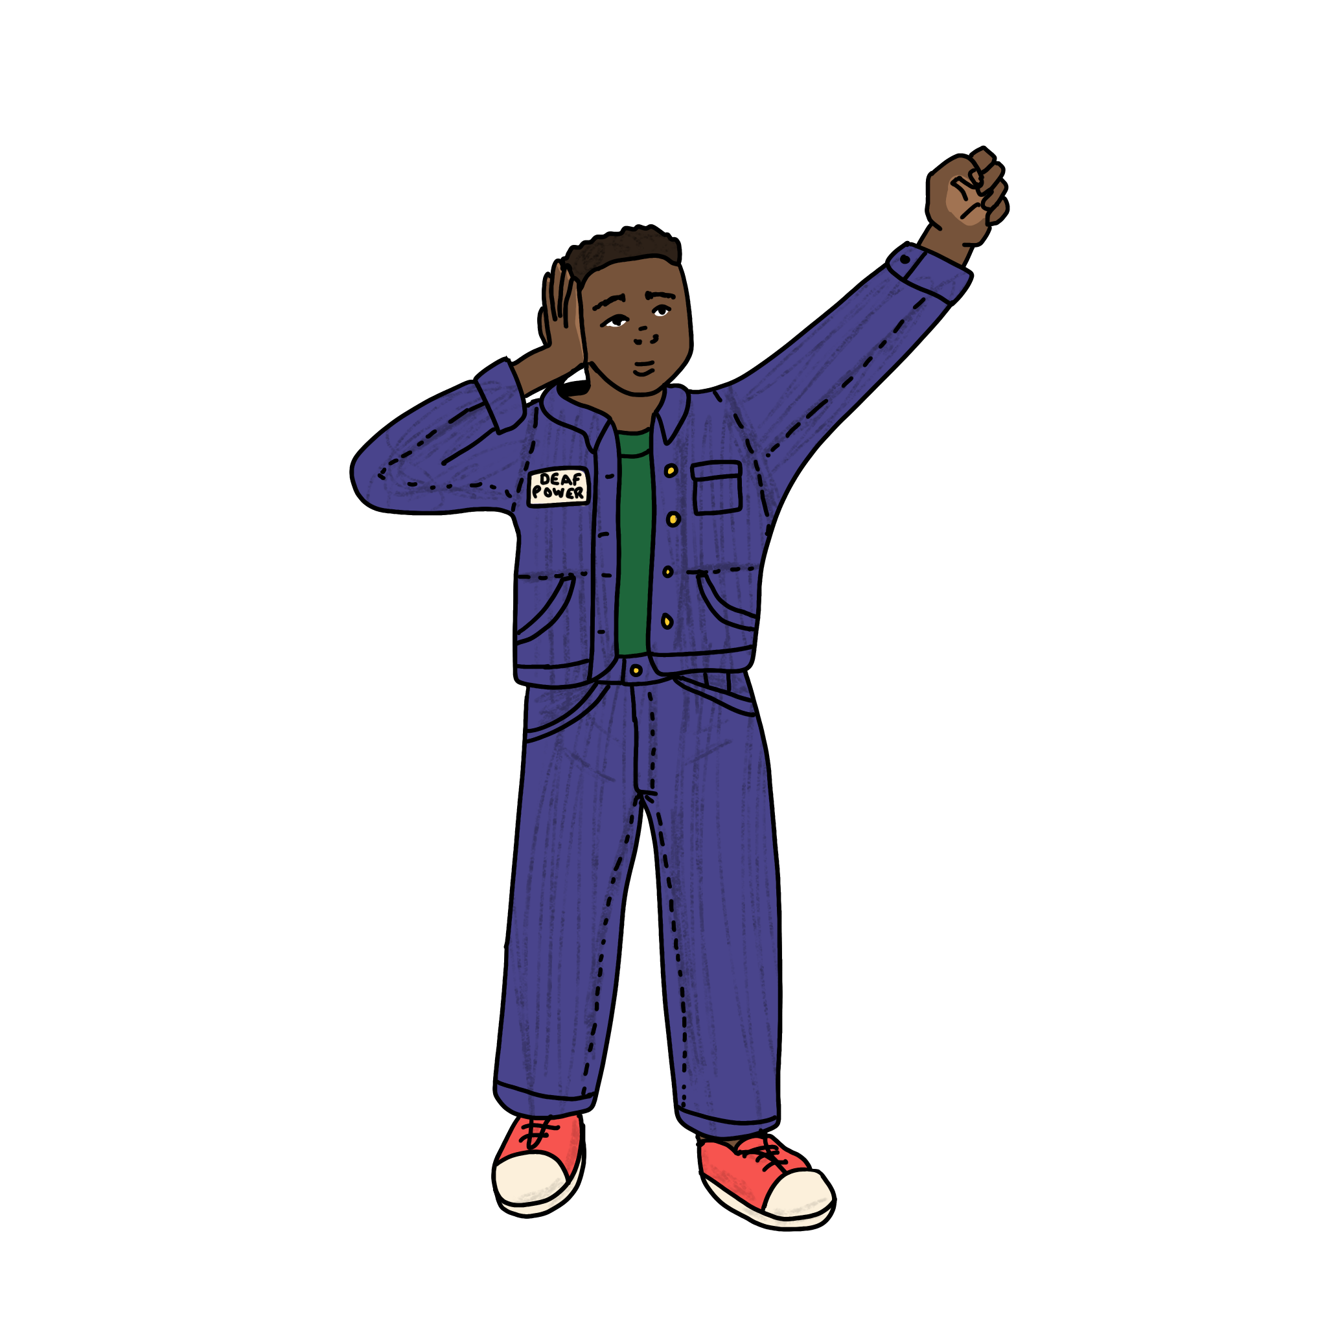
Share your Interview Experiences

Slide 51
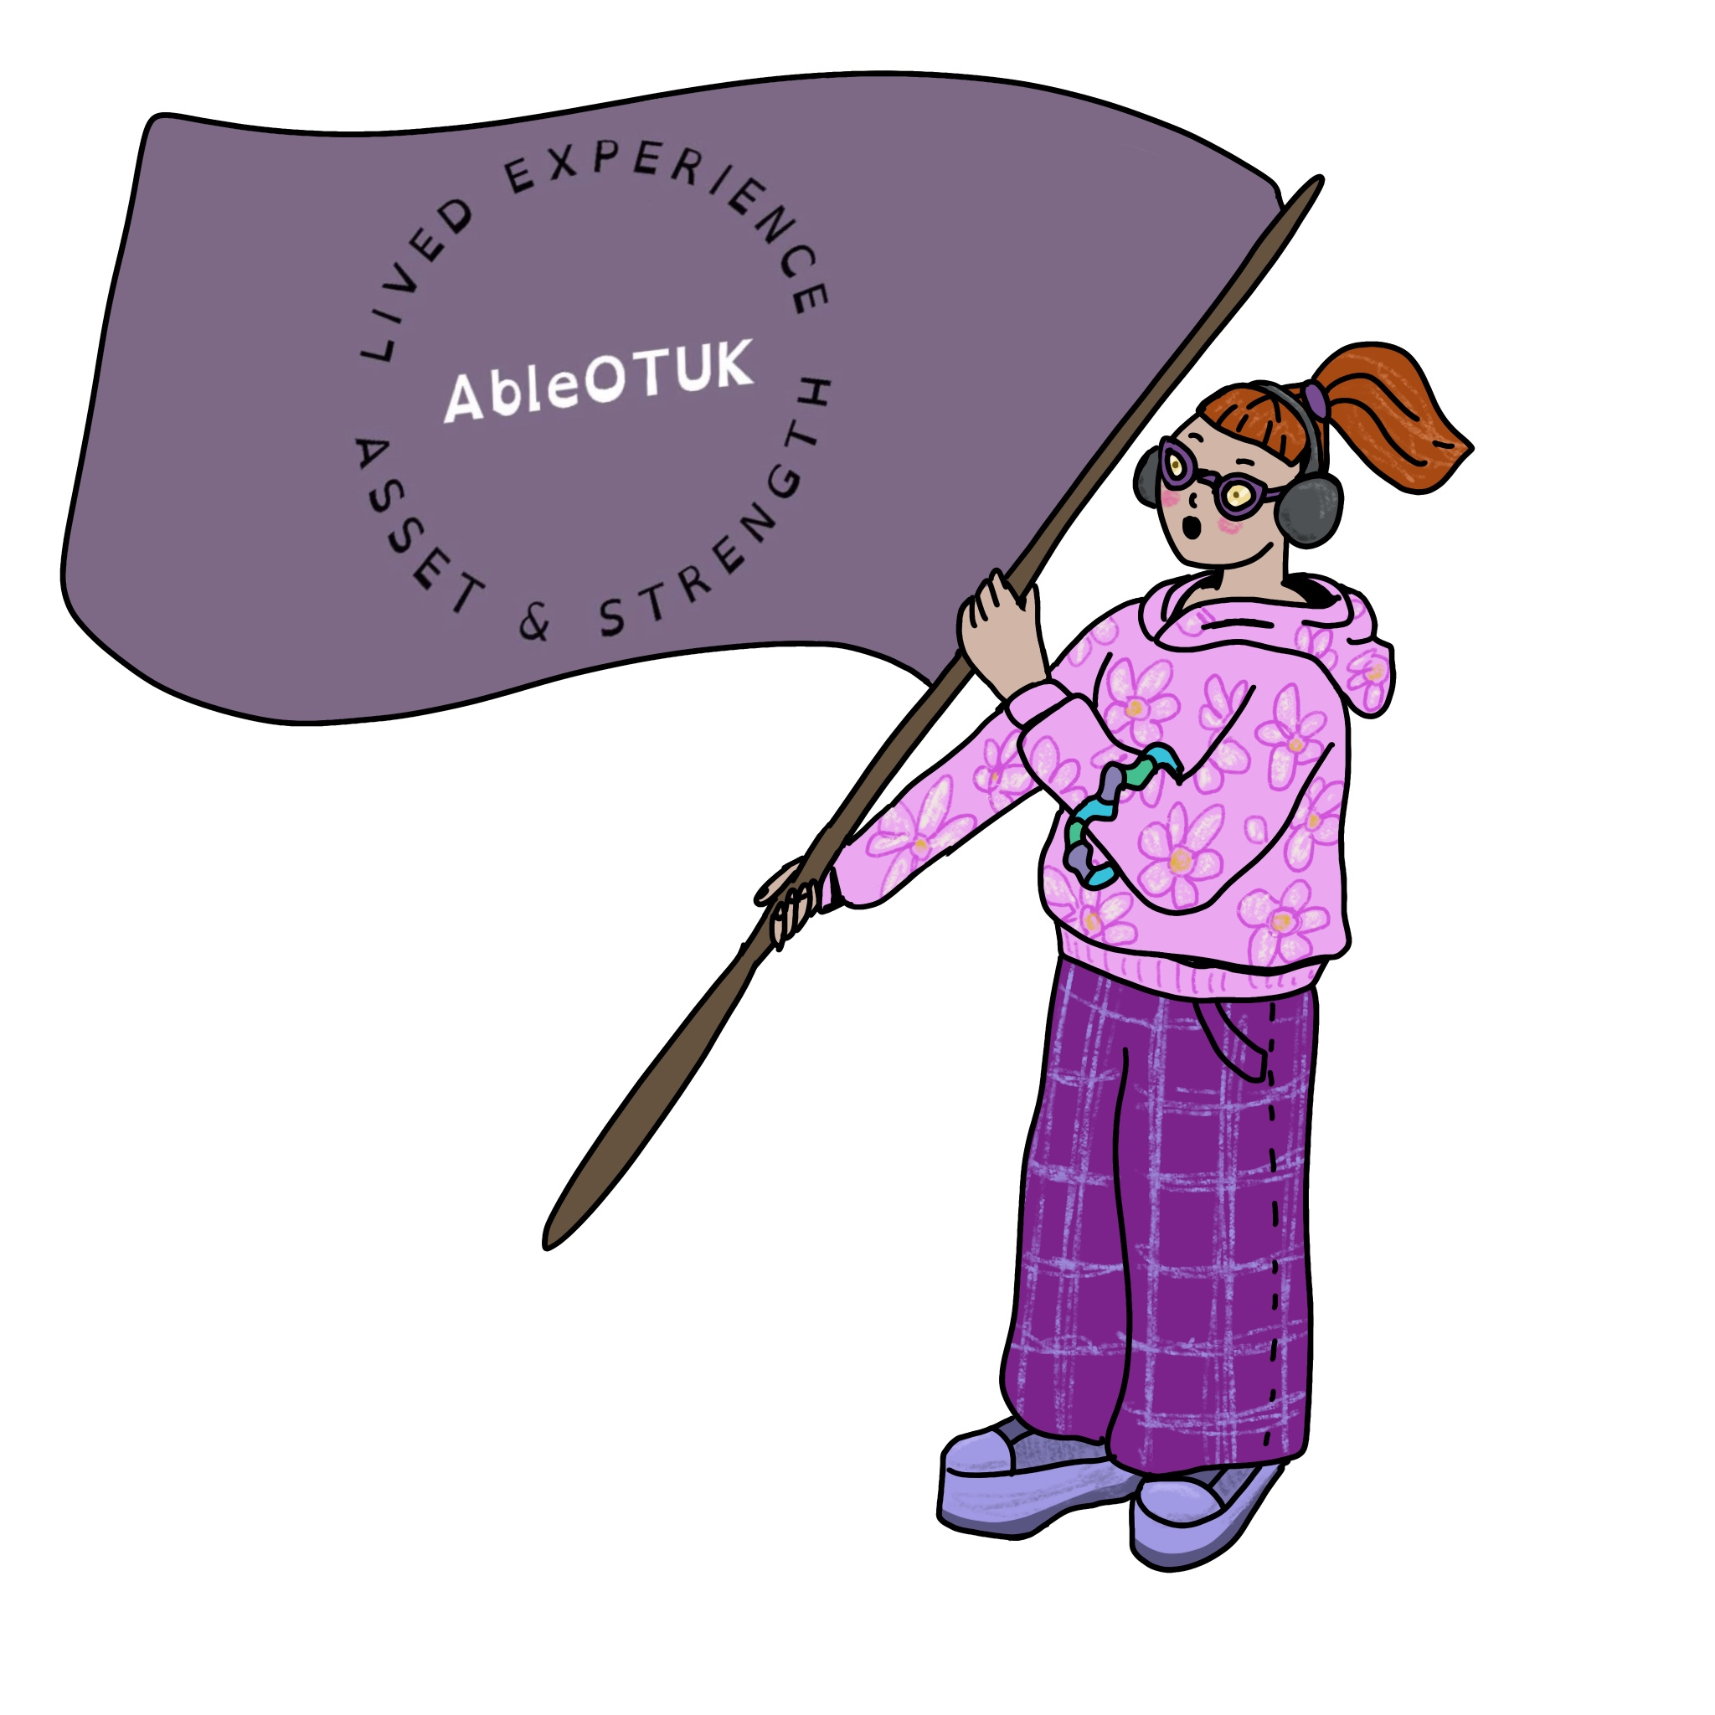
Do you have any questions?
What are your reflections about this evening’s presentations or the AbleOTUK journey?
Do you have examples of where AbleOTUK has had an impact? Personally or wider.
(Put your hand up to speak or use the chat function).
Now over to you…

Slide 52
What’s next for AbleOTUK?
What Ideas can you share with us?
(unfortunately, we can’t promise to do everything)

Slide 53
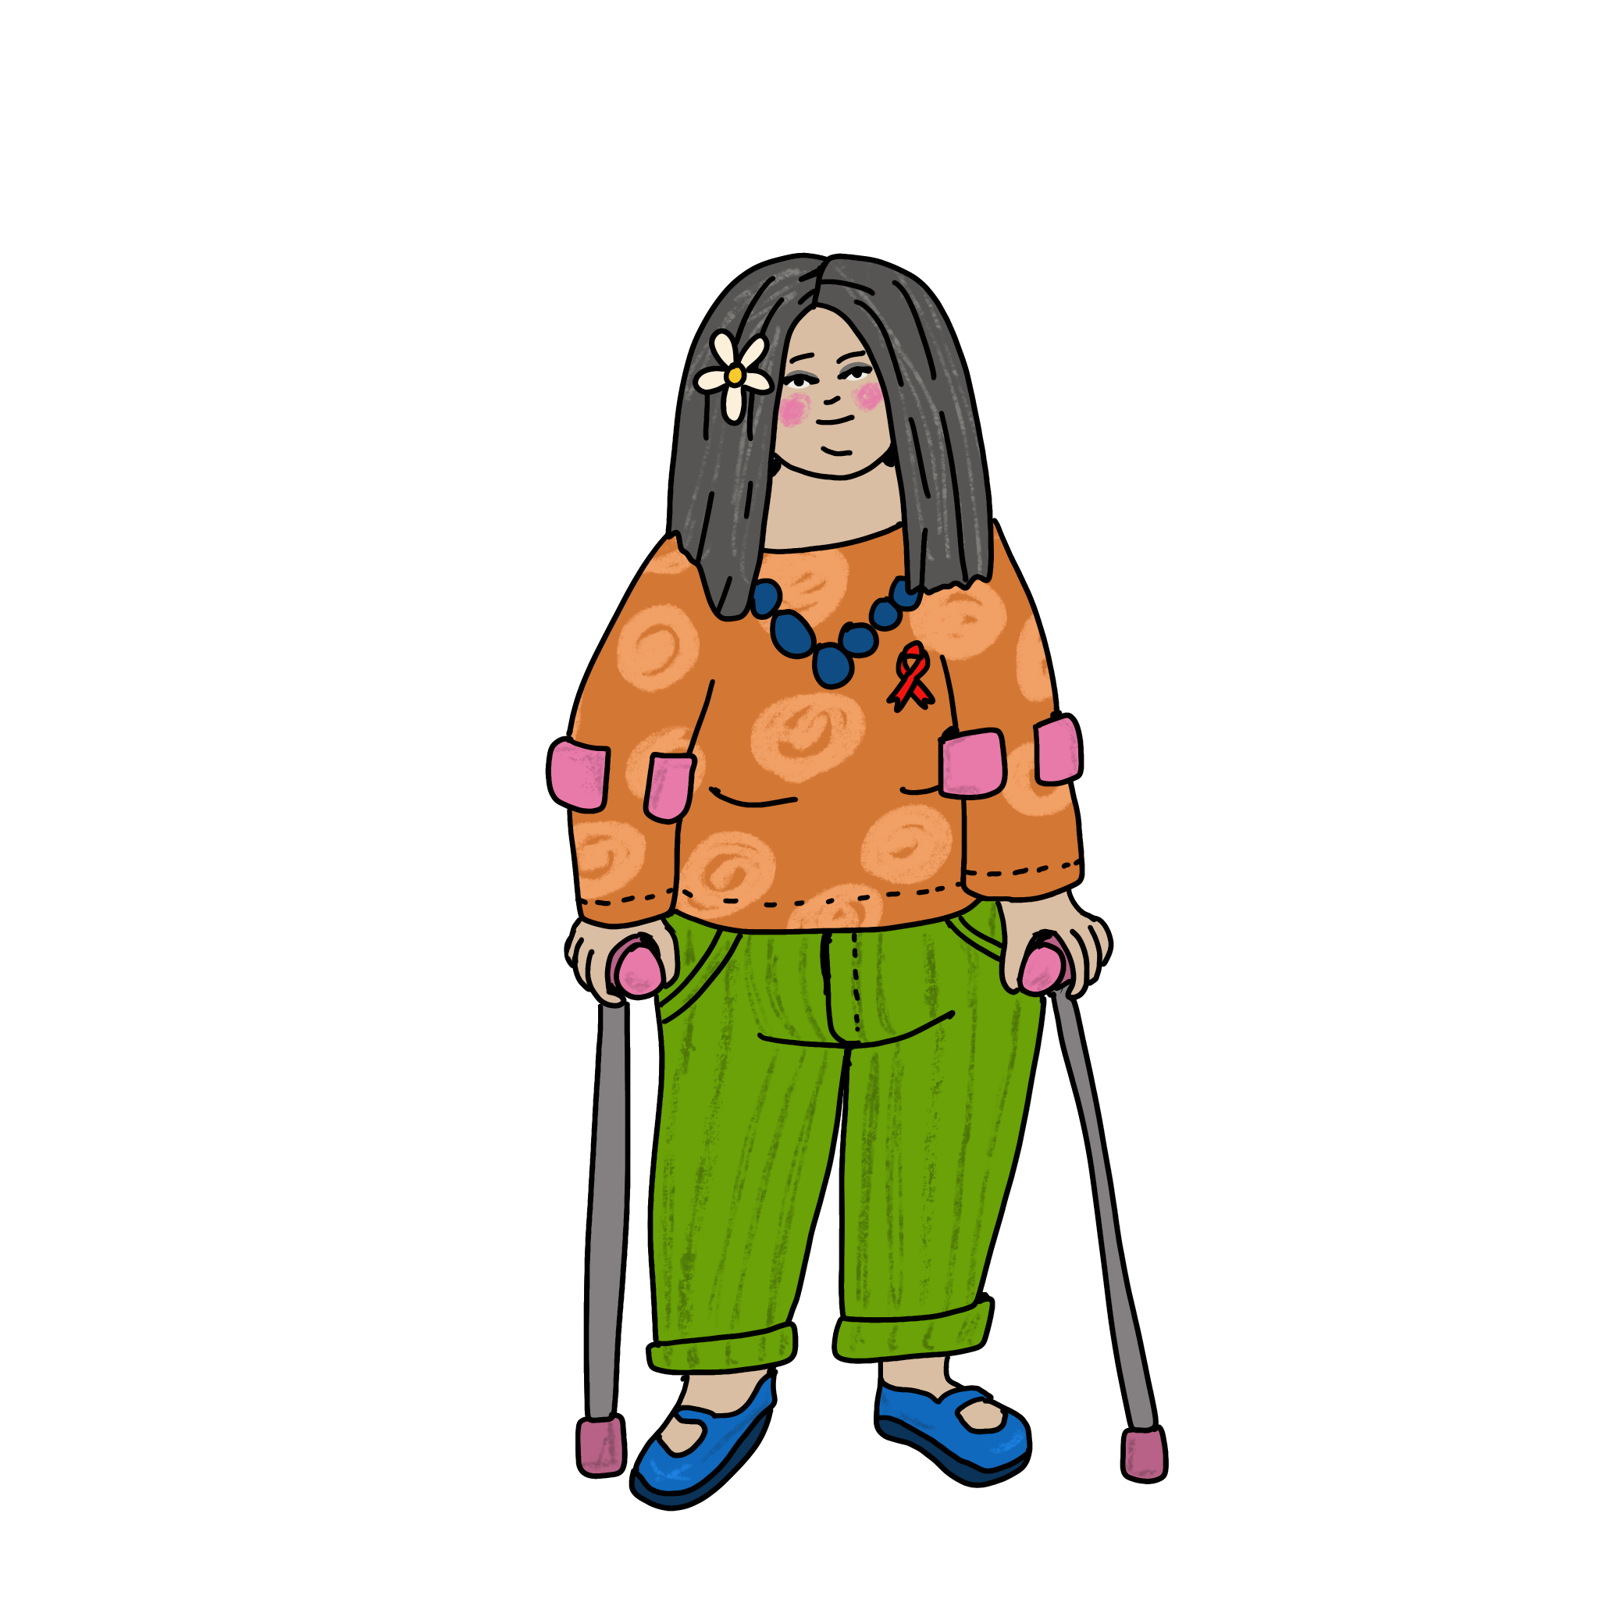
What’s next for AbleOTUK?
Sharing and building on the student’s work on reasonable adjustments
Simulation as a learning method - encouraging more thought and reflection
Give challenge to the profession where it is needed regarding inclusive practice.
And lots more….

Slide 54
